Slide 1
Constrained Multi-Objective Ship Design Optimization with a Limited budget of Function Evaluations
Roy de Winter |
The Joint Lectures on Evolutionary Algorithms,
Lecture 1 - 11th of September 2021
Notes:
I would like to start by thanking you for still beeing here, and a big thank you for the organizers. My name is Roy de Winter, PhD student at the NaCo group of Thomas Bäck and Research and Development engineer at C-Job Naval Architects.
Today I will explain to you how a novel constrained multi-objective optimization works and how we used it to optimize a ship design.

Slide 2
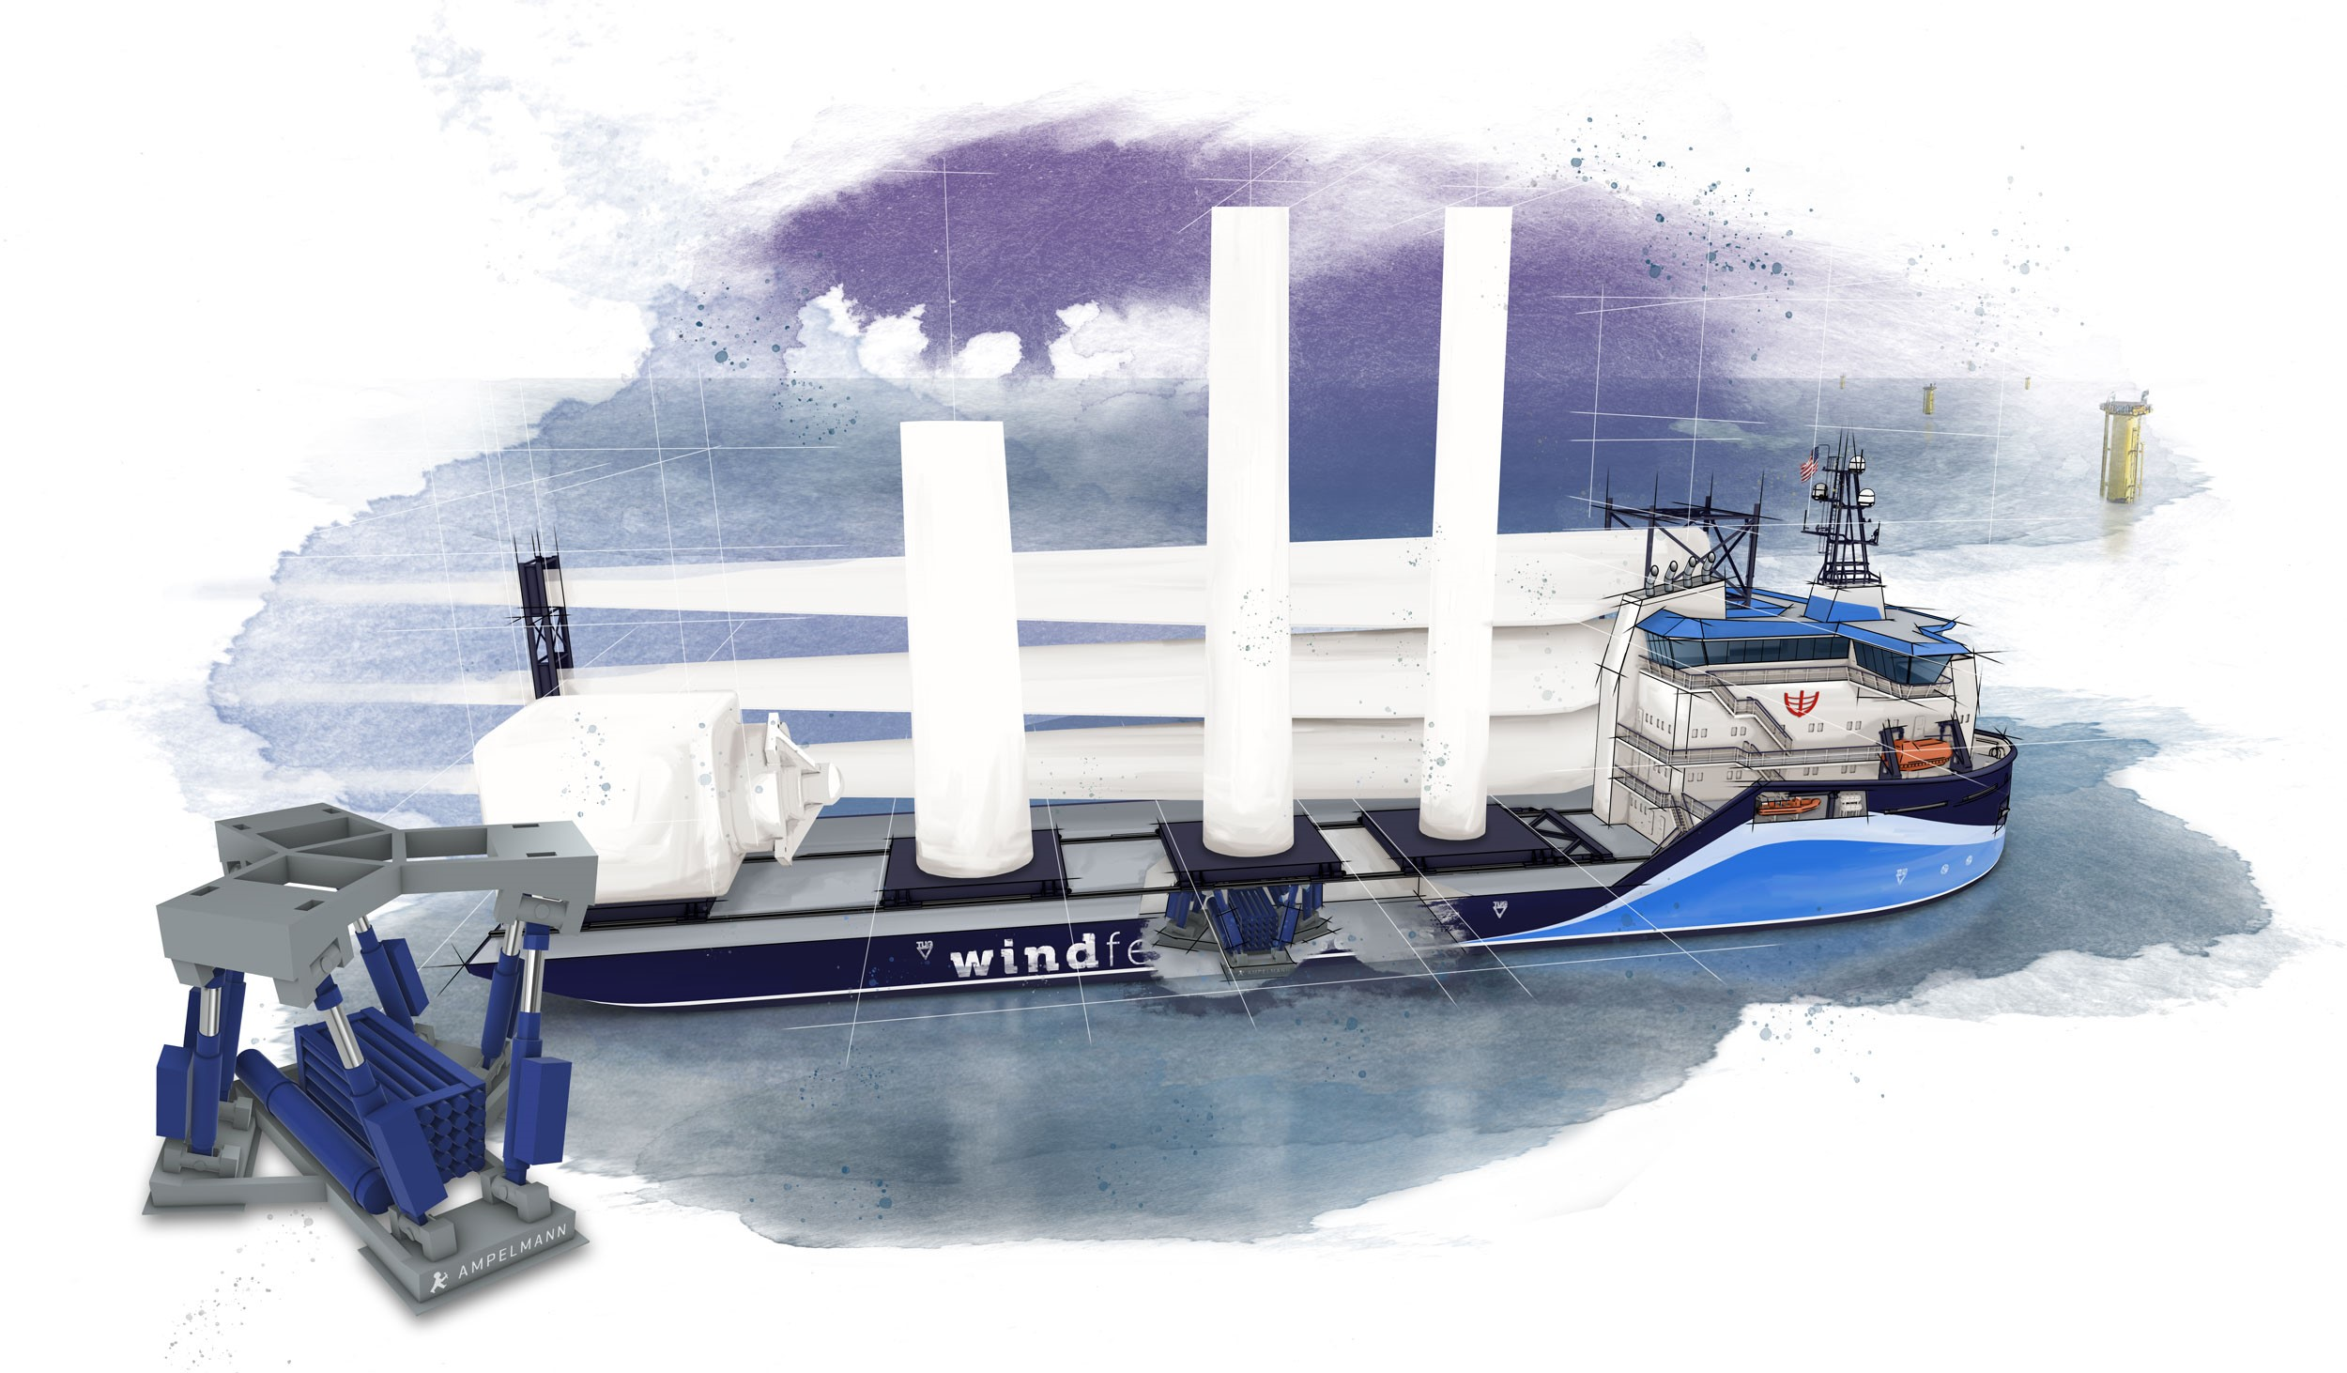
Outline
Introduction
Ship Design Case
Related Work
SAMO-COBRA
Experiments
Results
Conclusions
Roy de Winter
Notes:
The outline of this presentation is the following: I will first give an introduction and some definitions, I will then present the ship design problem, I will shortly describe some related work, then we come eto the explanation of the novel algorithm named SAMO-COBRA, I will tell how we tested the algorithm and finally I will show the results and draw the conclusions

Slide 3
Introduction
Recent survey mentions [17]
Continuous optimization variables
Constraints
One or more objectives
Topological characteristics of objective space are unknown
Long evaluation times
Constrained Multi-objective problem:
Roy de Winter
Notes:
A recent survey of a questionnaire reported that Real world problems often involve
continuous optimization variables,
Constraints,
One or more objectives
Topological characteristics of the objective space are often unknown.
On top of this, Long evaluation times make the problems hard to solve.
This results in a need for an efficient surrogate assisted optimization algorithm.
Since already some good single objective optimization algorithms exist, in this work we focus on multi-objective algorithms.
A constrained multi-objective problem is defined as follows. We minimize a vector of objective functions, subject to 1 or more constraint functions, and the decision variables are continue and bounded by a lower and upper limit.

Slide 4
Introduction
Recent survey mentions [17]
Continuous optimization variables
Constraints
One or more objectives
Topological characteristics of objective space are unknown
Long evaluation times
Roy de Winter
Notes:
We are solving this multi objective problem by looking for Feaesible pareto-Optimal solutions.
A solution is feasible pareto-optimal if and only if there is no solution for which another solution dominates this solution in all objective directions, while not violating any of the constraints.

Slide 5
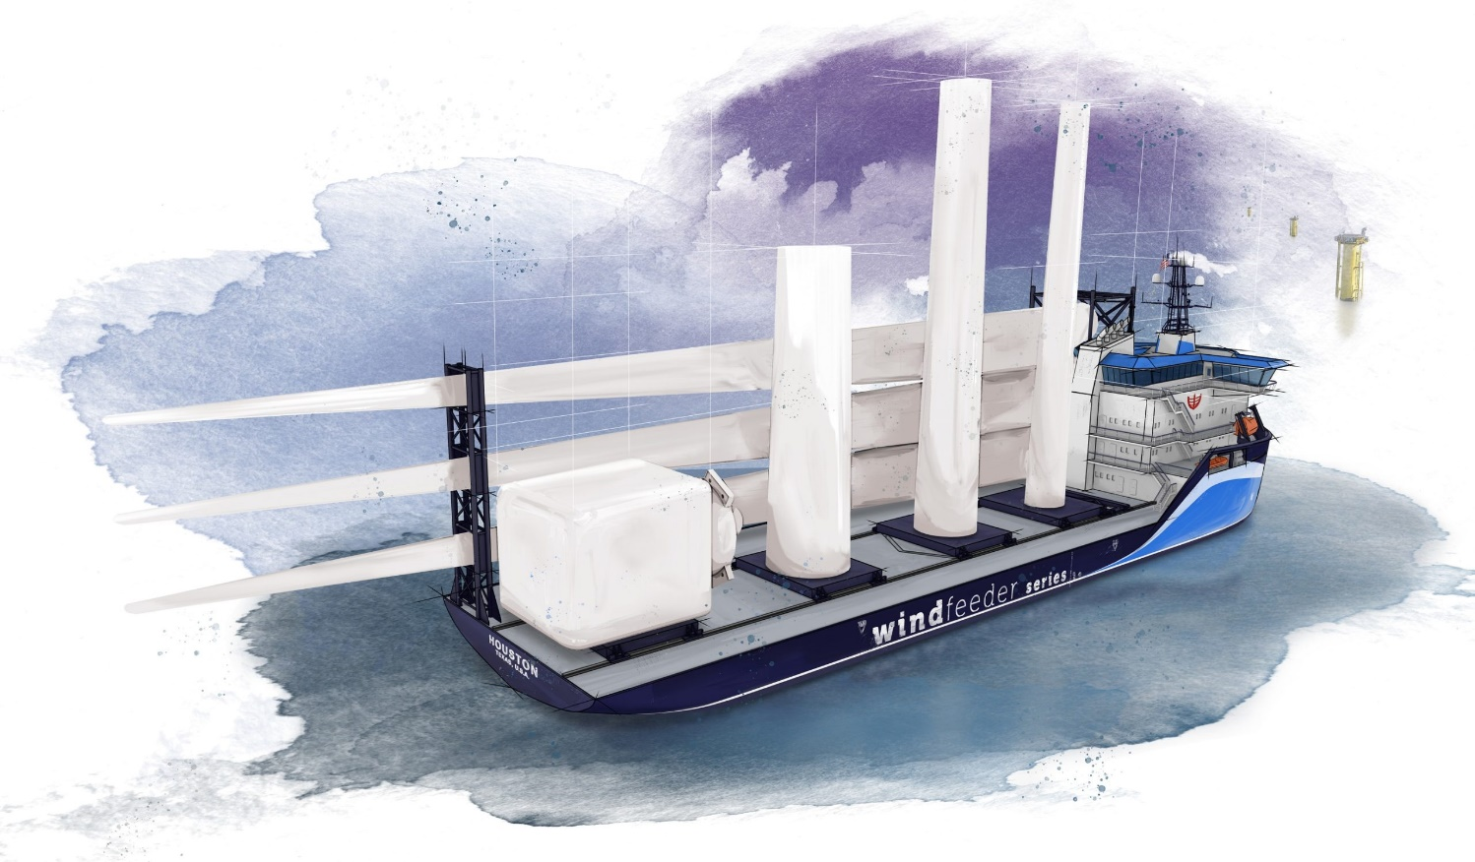
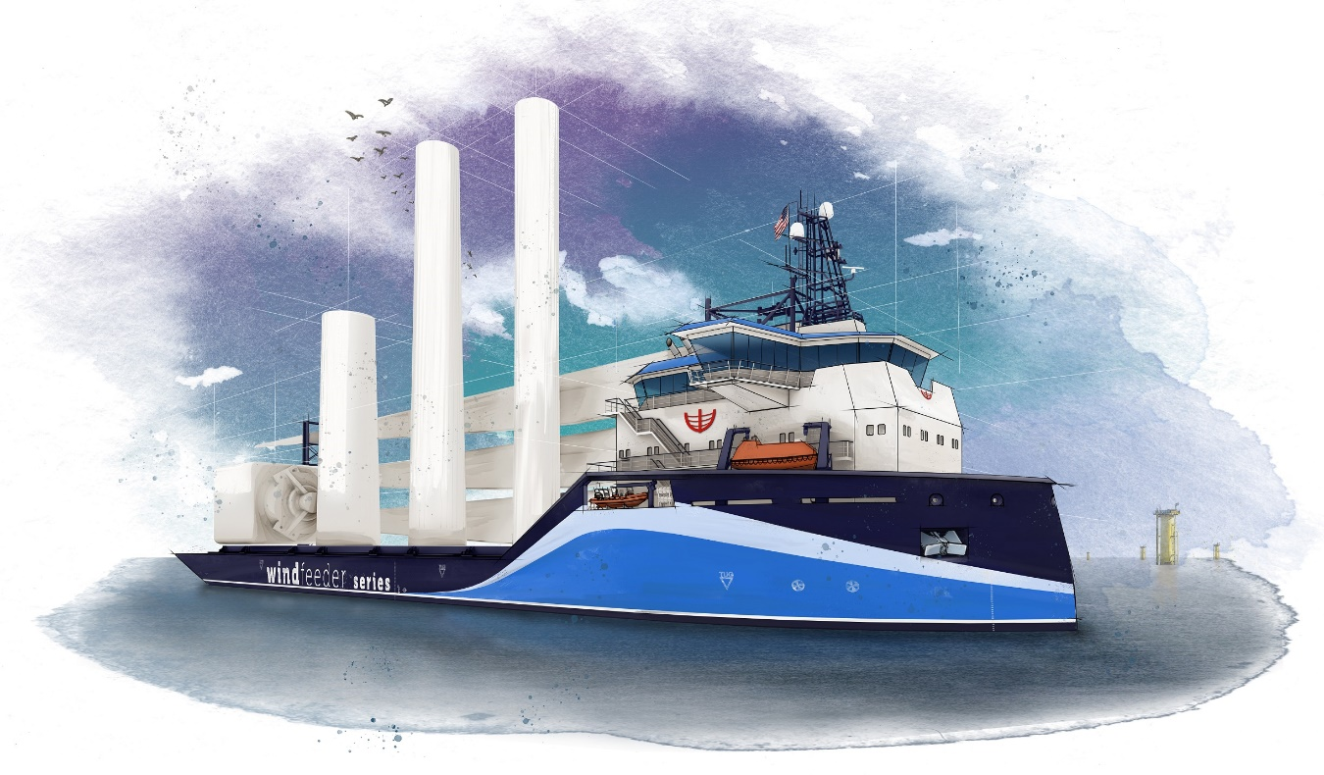
Ship Design Case
Roy de Winter
Notes:
Lets zoom in on such a multi objective optimization problem.
This is a wind feeder vessel designed by C-Job Naval Architects.
This vessel brings wind turbines from shore to the installation site on the sea.
Although strong winds are good for power production, strong winds usually also result in rough seas. These rough seas around the wind park installation sites increases the demand for reliable vessels.

Slide 6
Ship Design Case
Aftship length
Midship length
Foreward ship length
Beam at waterline
Draught
Roy de Winter
Notes:
To optimize the reliability of a vessel, a design is created and optimized. The parameters which are considered are:
Aftship length
Midship length
Foreward ship length
Beam at waterline
Draught

Slide 7
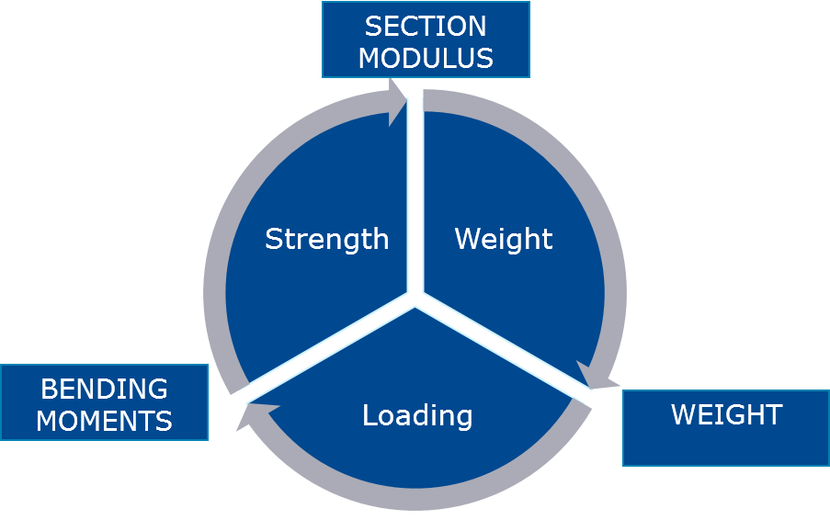
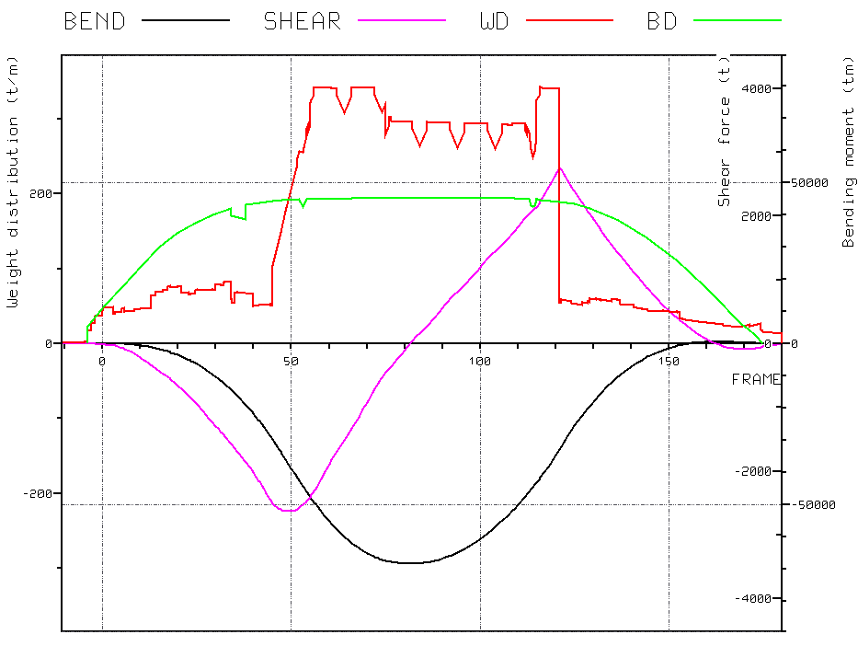
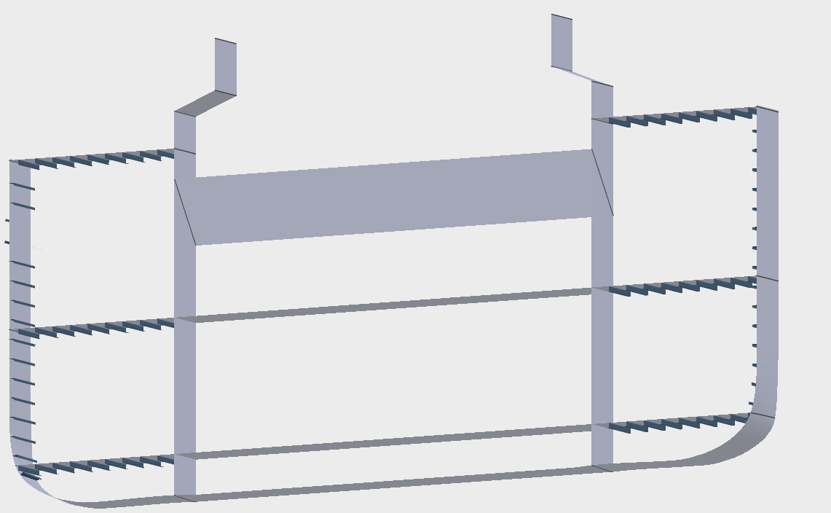
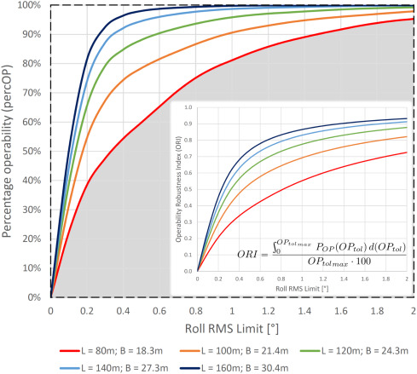
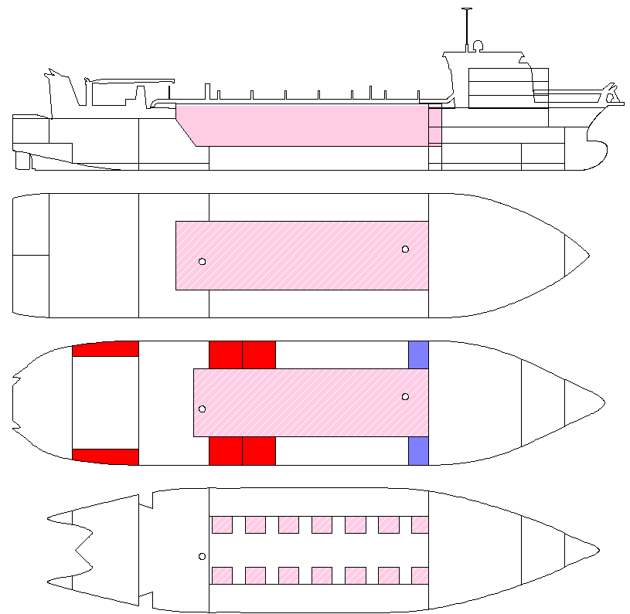
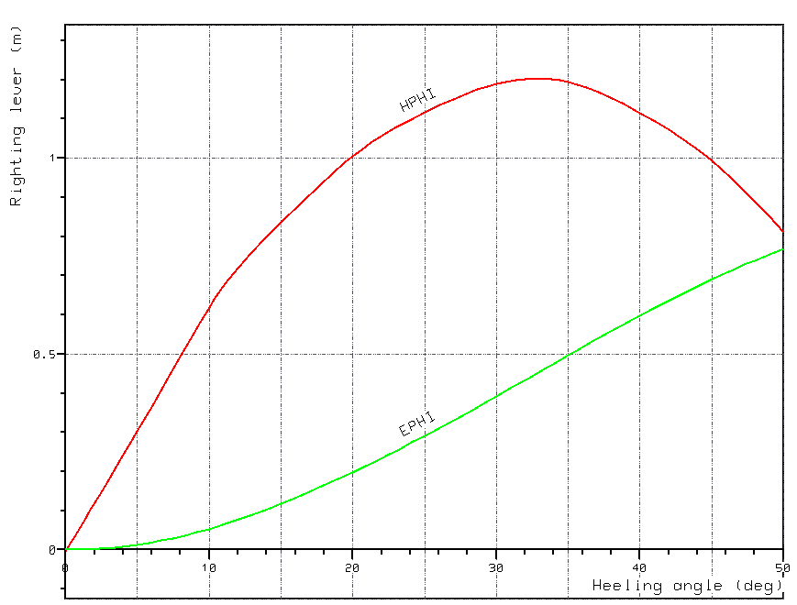
Ship Design Case
Ship resistance at service speed
Roy de Winter
Notes:
We optimized for maximum operability, minimum capital expenses, and minimum operational expenses.
The capital expences (roughly equal to the weight in steel it requires to build the vessel),
and operational expenses which can be translated to ship hull resistance at service speed.
And the year round operability is optimized. In the heavy wind and waves, mentioned earlier not every vessel can operate. We therefore optimize the so called operatability robustnes index. Also known as ORI parameter.
Longitudial strength so that the ship doesn’t break
Space reservation constraint
Intact stability / metacentric height. Doesn’t capsize.

Slide 8
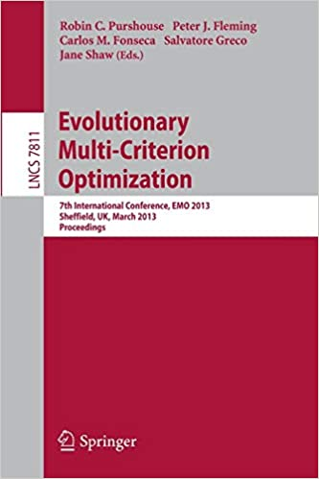
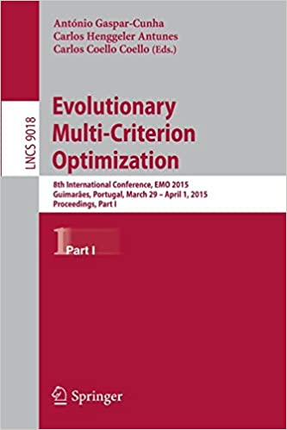
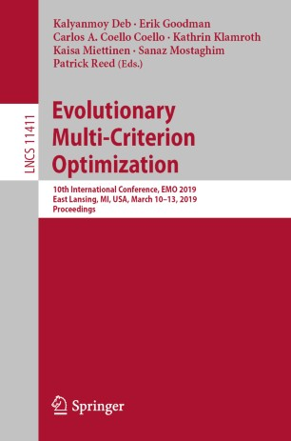
Related Work
Fast surrogate assisted constraint Optimization Algorithm
SACOBRA [3]
Surrogate Assisted Multi Objective Optimization algorithms
SMS-EGO [21], PAREGO [16],
Without Meta-modelling
NSGA-II [10], NSGA-III [15], SPEA2 [30], SMS-EMOA [4]
With kriging Surrogates
CEGO [29], ECMO [25]
Fulfil all 3 requirements,
SMES-RBF [8], SA-NSGA-II [5], IC-SA-NSGA-II [5]
Roy de Winter
Notes:
So how do we optimize such a constrained multi objective problem?
There are three relevant requirements for a novel optimization algorithm. It should be
- fast,
able to deal with constraints,
and multi objectives
One algorithm who has most of these characteristics is SACOBRA, which is a very efficient constraint handling optimizer. However it is designed to optimize only one objective at a time.
There exists surrogate assisted algorithms for multi objective algorithms, however, they often miss a constraint handling mechanism like SMS-EGO and PAREGO or require a lot of function evaluations since they don’t use a metamodeling techniques. NSGA-II, NSGA-III, SPEA2 and SMS-EMOA are examples of such algorithms.
Then we have two algorithms who can deal with multiple objectives and multiple constraints: CEGO and ECMO. However since they use kriging surrogates their time complexity increases cubically for every added decision variable.
Finally one few algorithm fulfils all the requirements, SMES-RBF. SA-NSGA-II, and IC-SA-NSGA-II. We there fore compared our result with this algorithm. IC-SA-NSGA-II assumes that the constraints are inexpensive so only evaluates objectives when design is feasible.

Slide 9
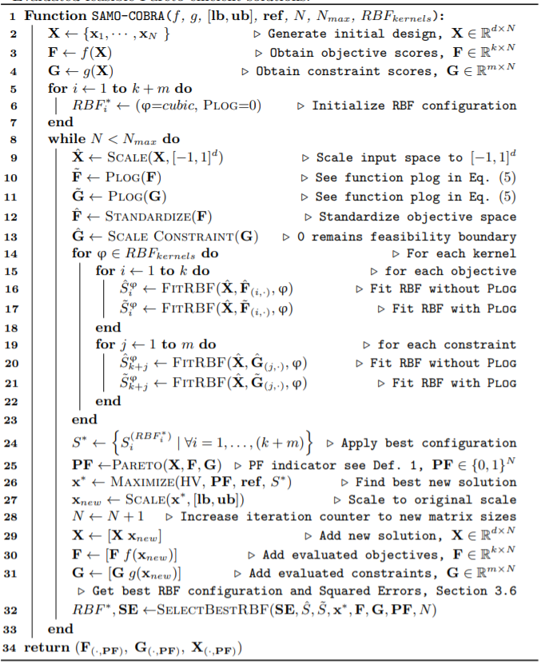
SAMO-COBRA
Self-Adaptive
Multi-Objective
Constrained
Optimization algorithm
By using
Radial Basis function Approximations
Roy de Winter
Notes:
Based on these algorithms I created a novel one, SAMO-COBRA. A self adaptive, multi-objective, constrained, optimization algorithm by using Radial Basis Function Approximations.
Here you can see the pseudocode, I will now go into detail and walk through it step by step.

Slide 10
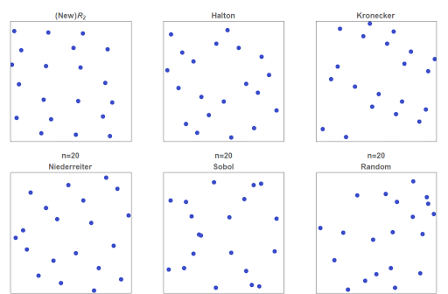
Initial Design
Halton Sample X of size d+1
Small as possible sample size give better results [6]
Evaluate on real objective and constraint functions
Roy de Winter
Notes:
First we start with an initial sample. This initial sample is a Halton sample, which is as small as possible. This since more adaptive sampling steps lead to better results compared to a less adaptive sampling steps with a bigger initial sample. In this work we use Radial basis functions as a surrogate. These functions can already be fitted with d+1 samples, so in case of 5 variables, 6 initial samples are enough.

Slide 11
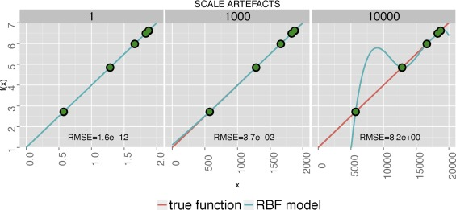
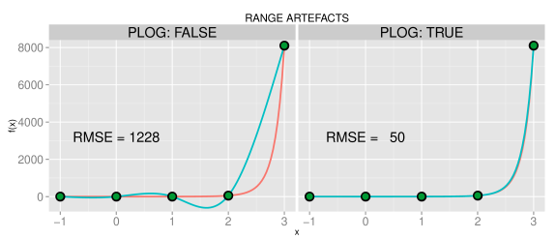
Scaling
Scale input space between [-1 , 1]
Prevent computationally singular coefficient matrices [3]
Standardize Objective Values
For uncertainty quantification method [2]
Scale Constraints
Make each constraint equally important [3]
PLOG
In case of steep slopes [3]
Roy de Winter
Notes:
Then the input space is scaled between -1 and 1, with this step you can prevent computational singular coefficient matrices If we wound’t do this we would risk the problem you see in the first 3 figures. So this step increases the precision of the surrogates.
Second step is standardize the objective values. This is done to make the objectives equally important and for the added uncertainty quantification method which requires a standardized score.
Then we scale the constraints to again make each constraint equally important.
Finally we apply the P-Log transformation in case there are steep slopes. This also decreases the RBF approximation error. Note that we both store the PLOG transformed values and de values without transformation here.

Slide 12
Surrogate Training
RBF surrogates
Multiple Kernels (φ)
Second order polynomial tail
Fit unique RBF model for:
Standardized objective scores
Plog transformed objective scores
Scaled constraint scores
Plog scaled constrained scores
Roy de Winter
Notes:
The objectives and constraints are modelled with RBFs. We fit radial basis functions with multiple kernels, namely:
cubic, gaussian, multiquadric, inverse quadratic, inverse multiquadric thin plate spline
Second order polynomial tail to prevent ill conditioning
Here the plog transformated values come back again. We train a surrogate for both the transformed values and only the scaled and/or standardized values.

Slide 13
Select the best Surrogate
RBFs exactly fit the training points
Not possible to chose best RBF after training
After evaluation it is possible!
Initially we use a cubic kernel and no PLOG transformation
After each iteration we store the squared approximation error
Selection of best RBF model based on:
Historic approximation errors of the Pareto Efficient points
+
Historic approximation errors of the last four evaluations
Roy de Winter
Notes:
After we trained all the surrogate models, we select the model which fit the objective and constraint scores best.
Because RBFS exactly fit the training points, it is not possible to chose the best RBFs after training. But after evaluation of new solutions, it is possible to see which kernel and which transformation scored best.
Initially we start with a cubic kernel and no transformations.
In each iteration we store the squared approximation errors and then based on these historic approximation errors. In each iteration we select the best RBF model and transformation. This selection is based on the approximation error of the pareto efficient points and the last for evaluations. This so that the algorithm does not get stuck in a local optimum and so that all the vicinitys of the optimal points are considered.

Slide 14
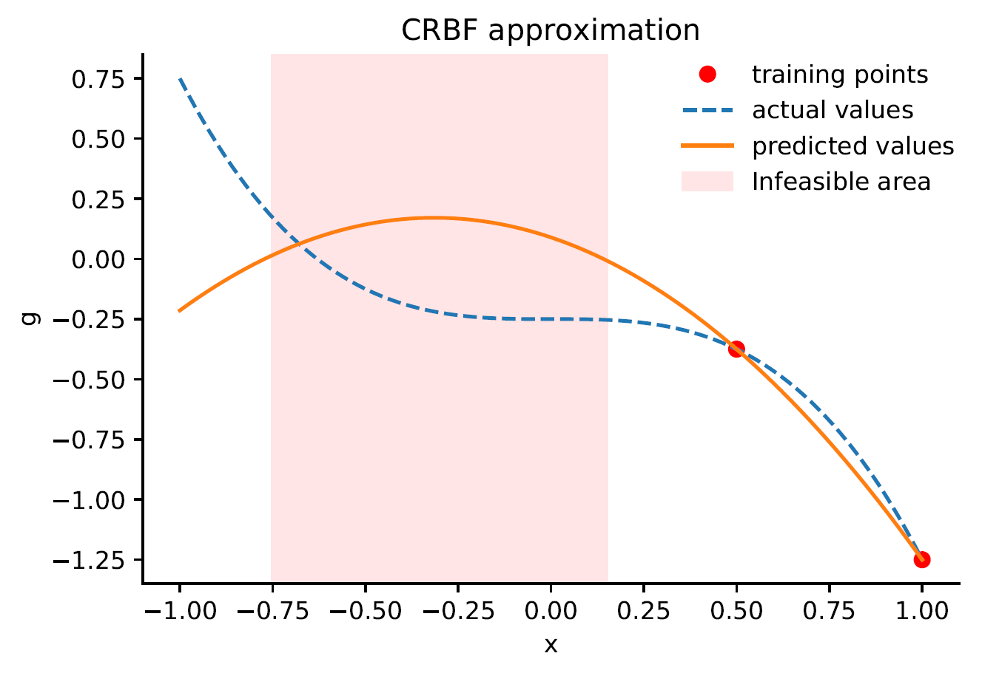
Surrogate Exploration
Select next solution based on feasibility
Roy de Winter
Notes:
Then after a good surrogate model and transformation has been selected, the surrogates are explored to find a new optimal solution. In each iteration the surrogates become better. Here you can see the first iteration of an example constraint. On the y axis you see the constraint score, smaller then 0 is feasible, on the x axis you see the decision variable. The red area is infeasible.

Slide 15
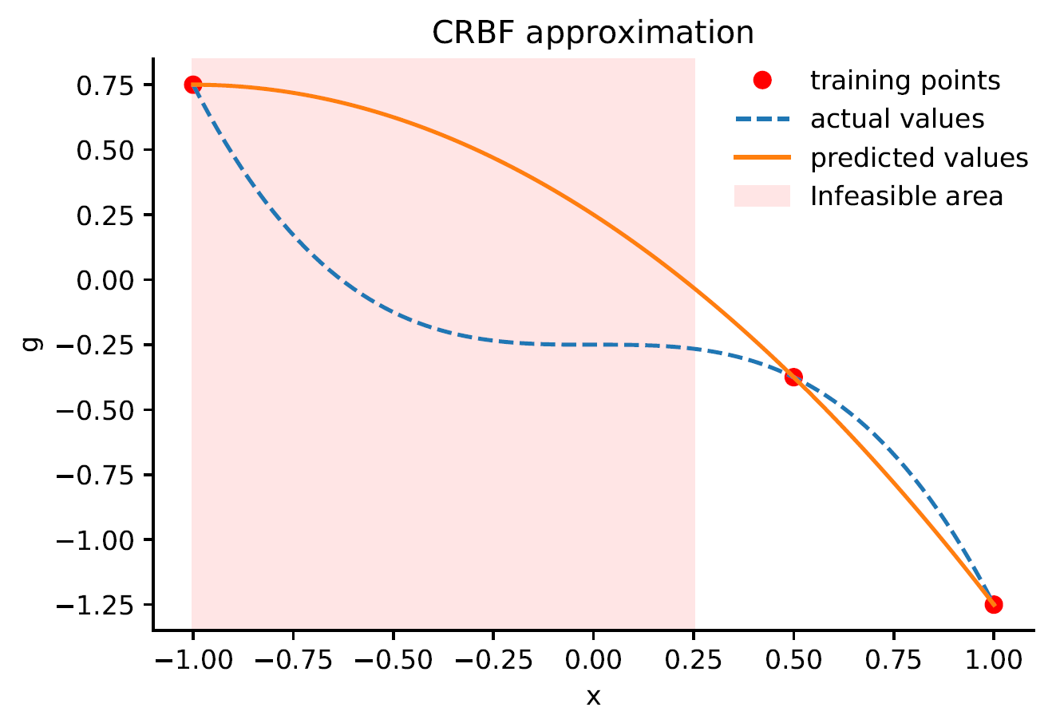
Surrogate Exploration
Select next solution based on feasibility
Roy de Winter
Notes:
After an evaluation the infeasible area changes, and the search happens in the feasible region.

Slide 16
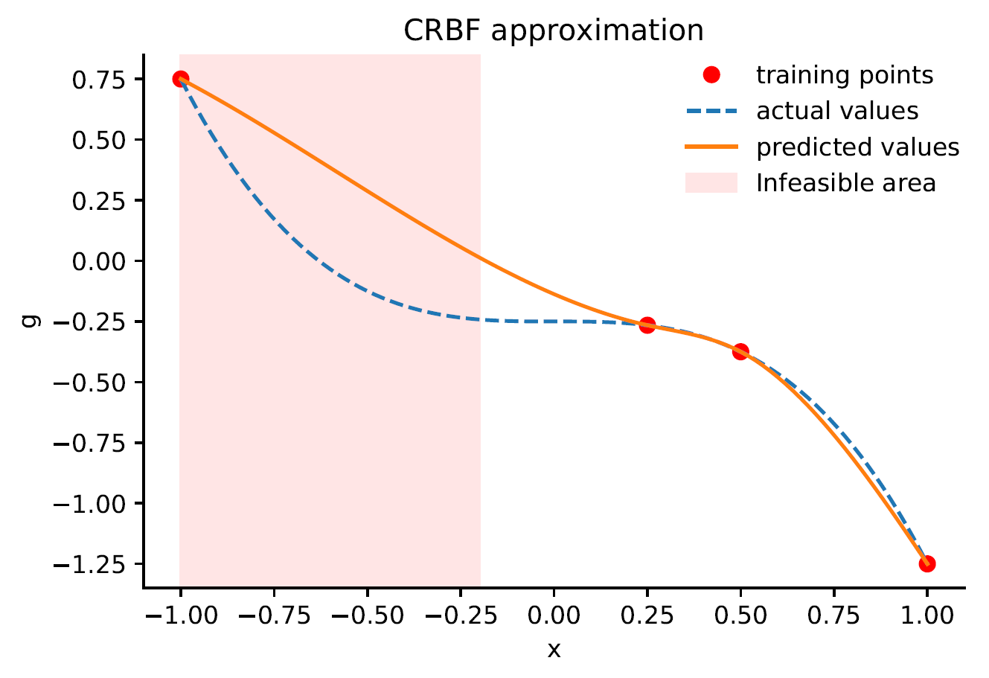
Surrogate Exploration
Select next solution based on feasibility
Roy de Winter
Notes:
After evaluation of a solution on the boundary of the constraint, the approximation becomes better again

Slide 17
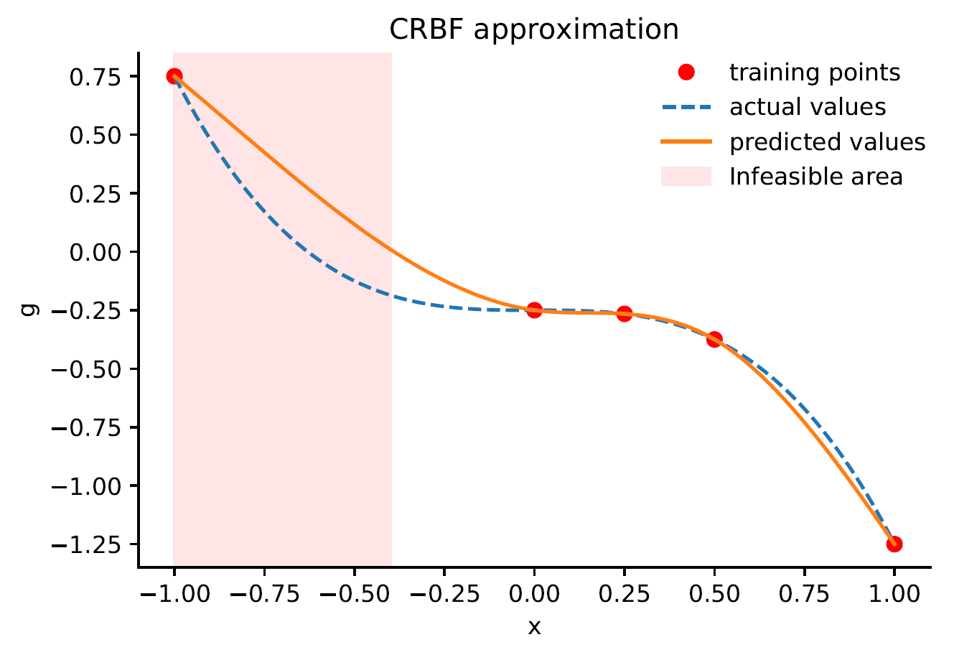
Surrogate Exploration
Select next solution based on feasibility
Roy de Winter
Notes:
And in the fourth iteration even better. The objectives are modelled the same way, only there is no infeasible region.

Slide 18
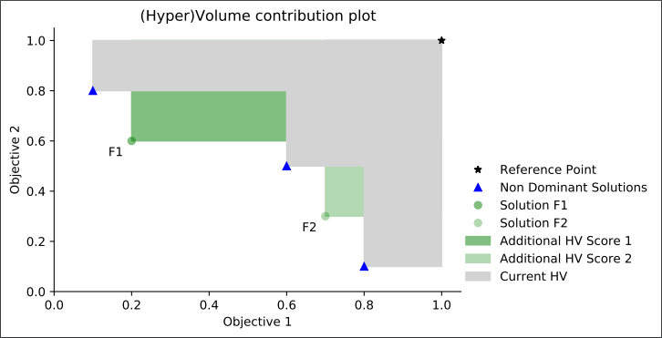
Surrogate Exploration
Select best solution based on maximized HyperVolume (HV)
Roy de Winter
Notes:
Then, to translate a multi-objective problem into a single objective problem, we maximize the hypervolume. The hypervolume is the volume between a novel potential solution and the solutions which have been evaluated before. As you can see here, the gray area is the pareto frontier, and the dominated green area of solution F1 is larger compared to the dominated green area of solution F2. Solution f1 would in this case be preferred since it adds more hypervolume. A novel Feasible solution with the best hypervolume is searched every iteration with the COBYLA algorithm. This solution is then evaluated and added to the solution-set. Then the surrogates are adjusted again and a new solution which adds the most hypervolume is sought again. This continues until the evaluation budget is exhausted.
We test two different versions of the hypervolume improvement infill criteria, one which takes uncertainty into account, better known as the SMS-metric selection criterion, and one which does not take uncertainty in account.

Slide 19
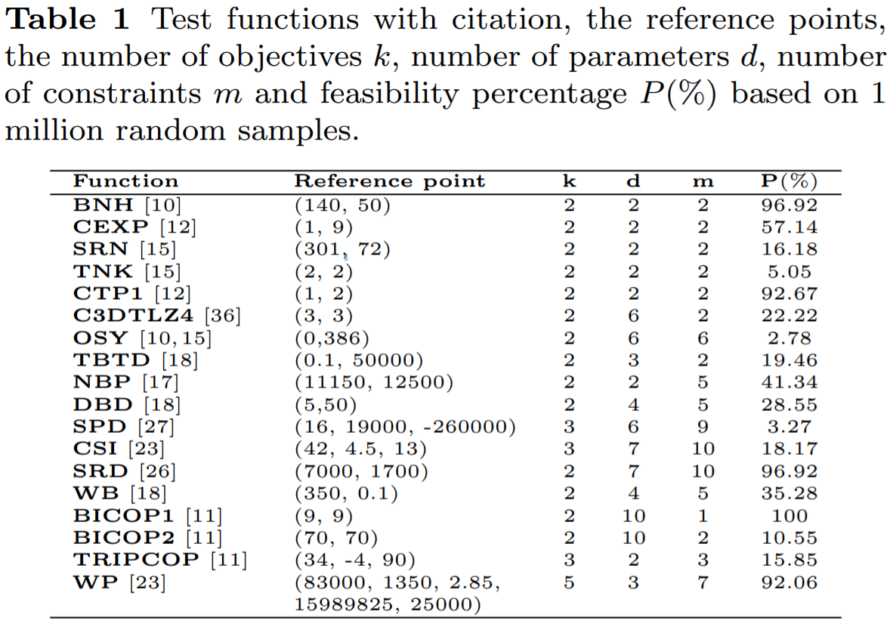
Experimental Setup
Experimented on 18 test functions
Multiple decision variables
Multiple constraints /feasible regions
Multiple objectives
Limited to 40*d function evaluations
2 variants are compared to
NSGA-II [10],
NSGA-III [15],
CEGO [29],
SA-NSGA-II [5],
IC-SA-NSGA-II [5],
SMES-RBF [8]
Roy de Winter
Notes:
The algorithm is tested on 18 constrained test functions which you see listed here. The test functions vary between 2 variables up to 10, and 2 objectives up to 5, and 1 constraint up to 10 constraints. Some are real world problems other are made up.
Also the percentage of search space that is feasible is different for each function.
We limit the algorithm to an evaluation budget of 40* number of decision variables. With these functions the pareto frontier should be found.
The algorithm is compared to the state of the art other algorithms.

Slide 20
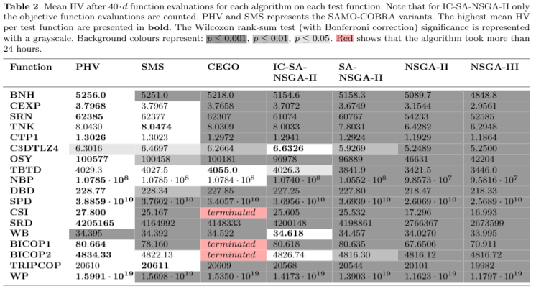
HV after 40*d function evaluations
PHV = Predicted Hyper Volume criteria SMS = S-Metric-Selection criteria,
without uncertainty quantification - With uncertainty quantification
Roy de Winter
Notes:
Each experiment is conducted 10 times. The scores you see here are the hypervolume scores after the fixed number of function evaluations. Two variants are compared, one with and without the uncertainty quantification method. As we see in this table, SAMO-COBRA without the uncertainty quantification method significantly outperforms the other algorithms. Although, in some cases the one with the uncertainty quantification method scores better, these results are never significant. In two cases the IC-SA-NSGA-II algorithm outperforms SAMO-COBRA. This is not super surprising since this algorithm used more then 10.000 constraint function evaluations.

Slide 21
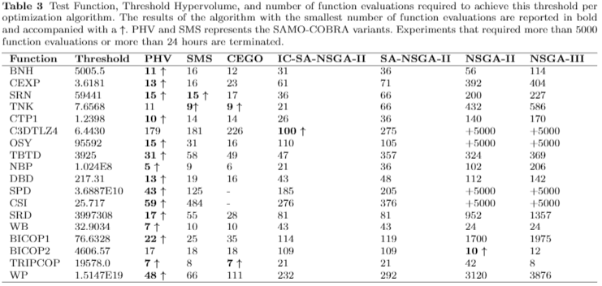
# Function evaluations for 95% of HV
PHV = Predicted Hyper Volume criteria SMS = S-Metric-Selection criteria,
without uncertainty quantification - With uncertainty quantification
Roy de Winter
Notes:
The scores you see here are the number of function evaluations that are required to achieve 95% of the hypervolume per test function per algorithm. Again we see that the samo-cobra algorithm with the predictetd hypervolume infill criteria outperforms the others in most cases.

Slide 22
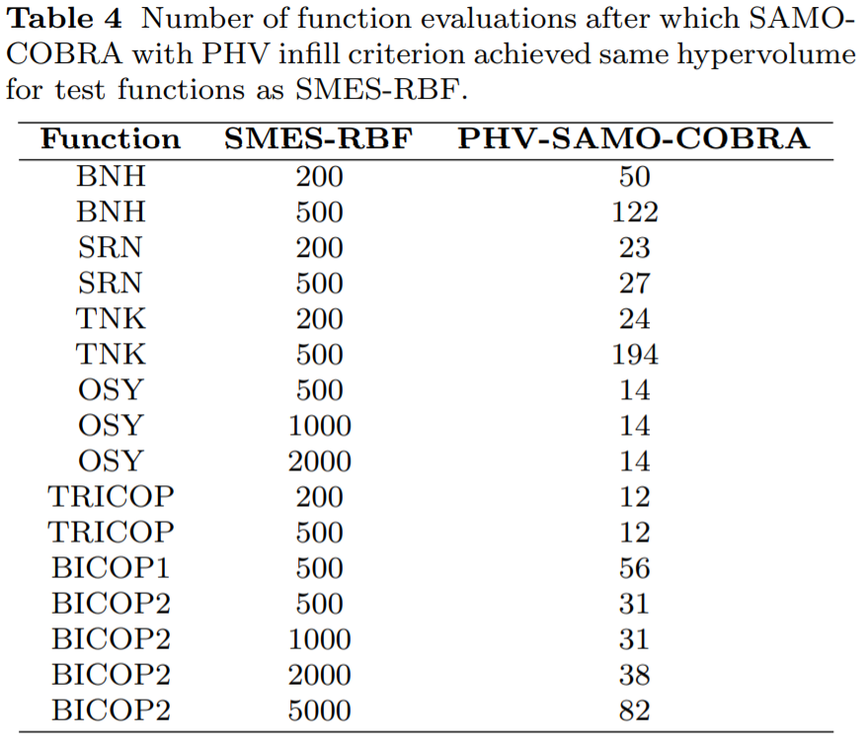
Results
Function Evaluations
SMES-RBF [8]
PHV-SAMO-COBRA
Roy de Winter
Notes:
Then a comparison was made between the results of SMES-RBF and SAMO-COBRA. In this table the number of required function evaluations to achieve the same HV as SMES-RBF algorithm. As you can see SAMO-COBRA requires much less function evaluations.

Slide 23
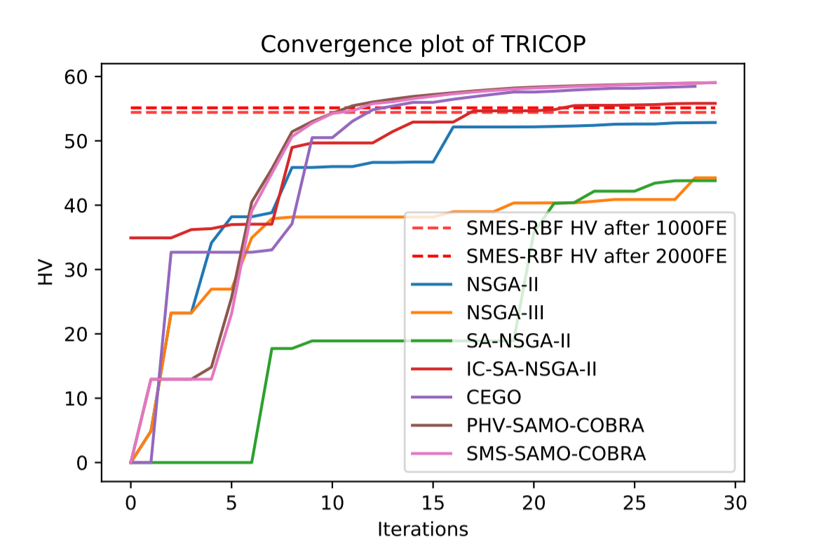
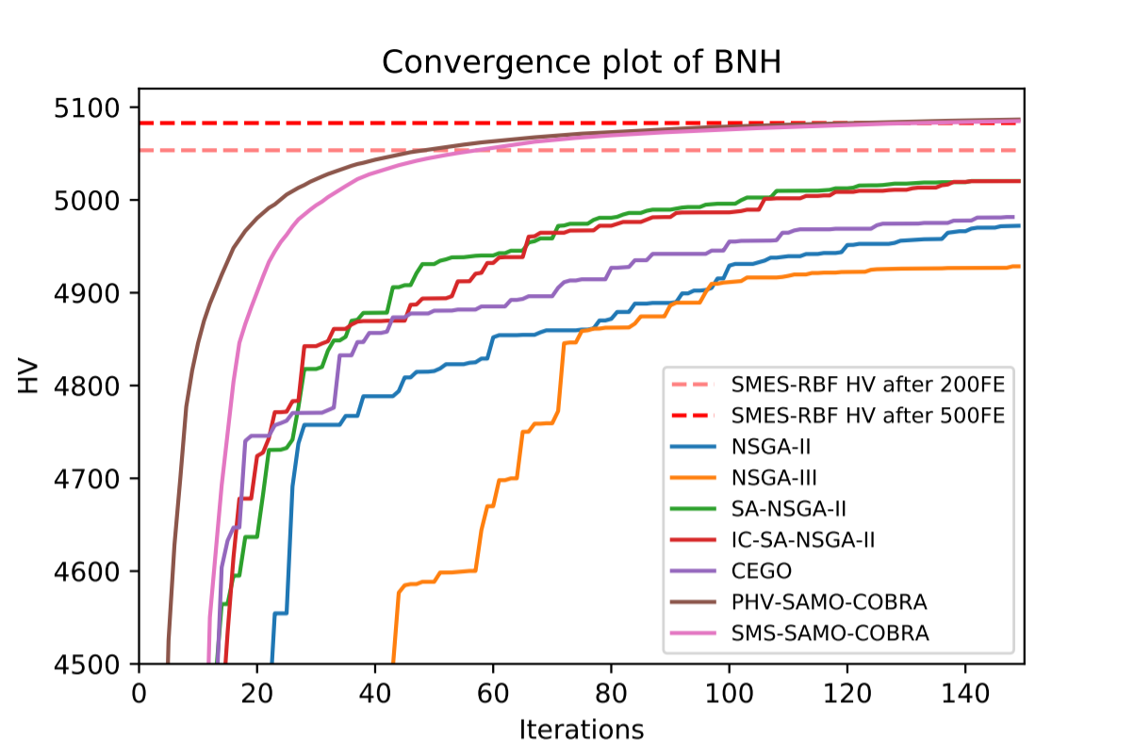
Results
Convergence plots of different algorithms
Roy de Winter
Notes:
Also here are some convergence plots of two test functions.

Slide 24
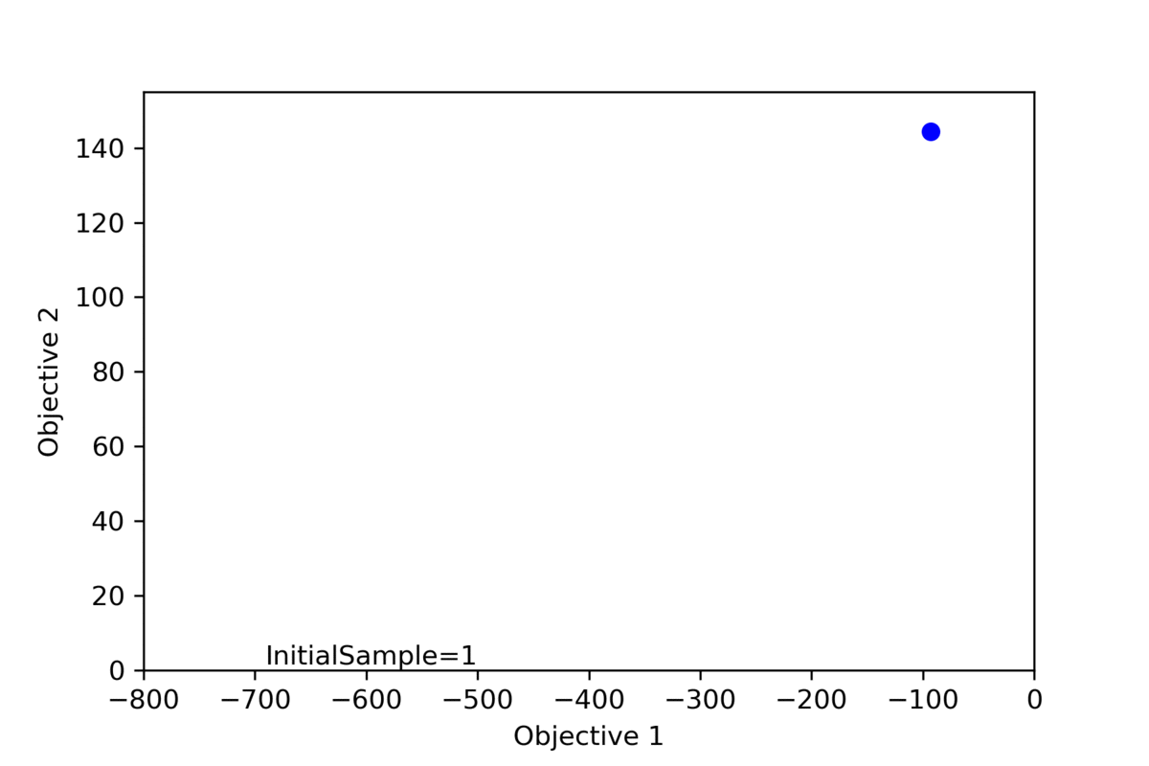
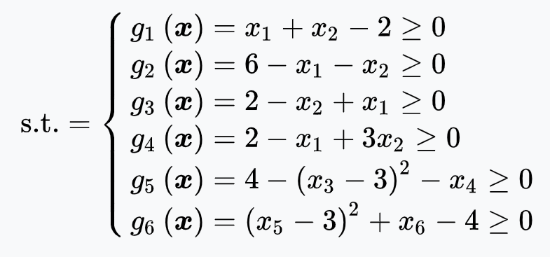
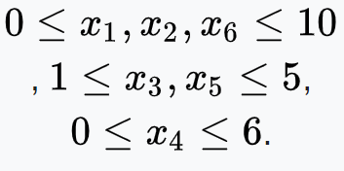
Example
Roy de Winter
Notes:
Lets zoom in on one example. The OSY test problem. This is the formulation with 6 decision variables, 2 objectives with some peeks and alleys, and 6 complex constraints. Less then three percent of the search space is feasible.

Slide 25
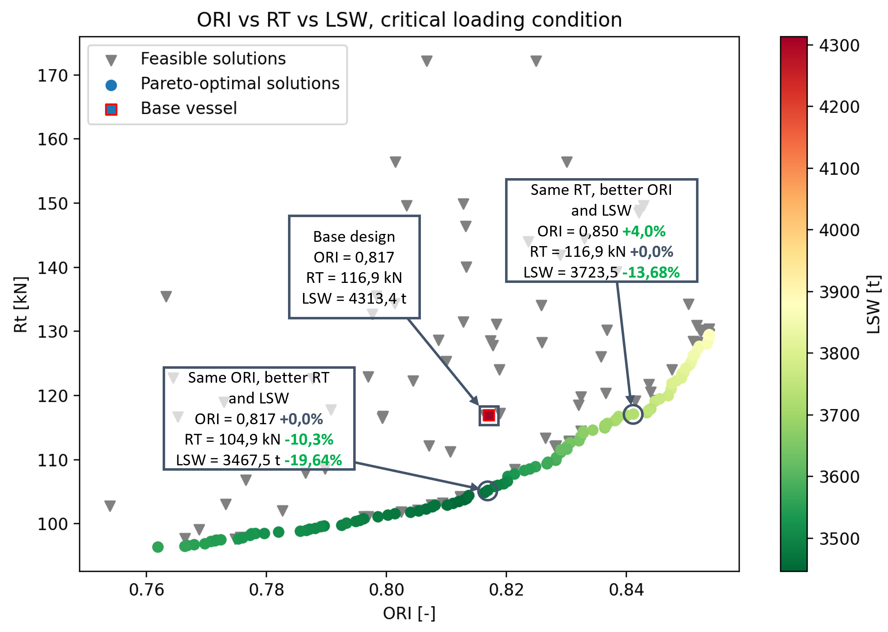
Ship Design Case
Option 1:
~20% less steel weight
~10% less resistance
Option 2:
~14% less steel weight
~4% better ORI
Or anything between or beyond
Roy de Winter
Notes:
Now the ship design case, after doing 300 function evaluations we found the tradeoff between the objectives, and obtained a pareto frontier. If we zoom in on two of the solutions we see that the initial design by the naval architect cansignificantly be improved in resistance, steelweight and operability.

Slide 26
Conclusion and Future Work
Use SAMO-COBRA when dealing with:
Continuous decision variables
Multiple objectives
One or more constraints
Expensive function evaluations
An surrogate uncertainty quantification method often does not lead to better results in the constraint multi-objective setting
Future efforts will go to
parrallelization,
mixed integer decision variables,
multi-fidelity simulation software
Roy de Winter
Notes:
So as a conclusion, use the SAMO-COBA algorithm in case you have continuous decision variables, multiple objectives, one or more constraints, and expensive function evaluations.
Then a recommendation, A surrogate uncertinaty quantification method often does not lead to better results in the constraint multi objective setting. This because here the algorithm is already forced enough to explore and uncertainty forces it to explore even more.
Future efforts will be put into parrallelization, mixed integer decision variable support, and multi-fidelity simulation software support to reduce wall clock time even more.

Slide 27
Thank you for your attention - References
[2] Bagheri, S., Konen, W., Bäck, T.: Comparing kriging and radial basis function surrogates. In: Proc. 27. Workshop Computational Intelligence. pp. 243–259 (2017)
[3] Bagheri, S., Konen, W., Emmerich, M., Bäck, T.: Self-adjusting parameter control for surrogate-assisted constrained optimization under limited budgets. Applied Soft Computing 61, 377–393 (2017). https://doi.org/10.1016/j.asoc.2017.07.060
[4] Beume, N., Naujoks, B., Emmerich, M.: SMS-EMOA: Multiobjective selection based on dominated hypervolume. European Journal of Operational Research 181(3), 1653–1669 (2007). https://doi.org/10.1016/j.ejor.2006.08.008
[5] Blank, J., Deb, K.: Constrained bi-objective surrogate-assisted optimization of problems with heterogeneousevaluation times: Expensive objectives and inexpensiveconstraints. In: H. Ishibuchi, Q. Zhang, R. Cheng, K. Li,H. Li, H. Wang, A. Zhou (eds.) Evolutionary Multi-Criterion Optimization, pp. 257–269. Springer Interna-tional Publishing, Cham (2021)
[6] Bossek, J., Doerr, C., Kerschke, P.: Initial design strategies and their effects on sequential model-based optimization. arXiv preprint arXiv:2003.13826 (2020)
[8] Datta, R., Regis, R.G.: A surrogate-assisted evolution strategy for constrained multi-objective optimization. Expert Systems with Applications 57, 270–284 (2016). https://doi.org/10.1016/j.eswa.2016.03.044
[10] Deb, K., Pratap, A., Agarwal, S., Meyarivan, T.: A fast and elitist multiobjective genetic algorithm: NSGA-II. IEEE transactions on evolutionary computation 6(2), 182–197 (2002). https://doi.org/10.1109/4235.996017
[15] Jain, H., Deb, K.: An evolutionary many-objective optimization algorithm using reference-point based nondominated sorting approach, part II: Handling constraints and extending to an adaptive approach. IEEE Trans. Evolutionary Computation 18(4), 602–622 (2014). https://doi.org/10.1109/tevc.2013.2281534
[16] Knowles, J.: ParEGO: a hybrid algorithm with on-line landscape approximation for expensive multiobjective optimization problems. IEEE Transactions on Evolutionary Computation 10(1), 50–66 (2006). https://doi.org/10.1109/tevc.2005.851274
[17] Liu, H., Ong, Y.S., Cai, J.: A survey of adaptive sampling for global metamodeling in support of simulation-based complex engineering design. Structural and Multidisciplinary Optimization 57(1), 393–416 (2018)
[21] Ponweiser, W., Wagner, T., Biermann, D., Vincze, M.: Multiobjective optimization on a limited budget of evaluations using model-assisted S-metric selection. In: International Conference on Parallel Problem Solving from Nature. pp. 784–794. Springer (2008). https://doi.org/10.1007/978-3-540-87700-4 78
[25] Singh, P., Couckuyt, I., Ferranti, F., Dhaene, T.: A constrained multi-objective surrogate-based optimization algorithm. In: 2014 IEEE Congress on Evolutionary Computation (CEC). IEEE (2014). https://doi.org/10.1109/cec.2014.6900581
[29] de Winter, R., van Stein, B., Dijkman, M., B¨ack, T.: Designing ships using constrained multi-objective efficient global optimization. In: International Conference on Machine Learning, Optimization, and Data Science. pp. 191–203. Springer (2018). https://doi.org/10.1007/978-3-030-13709-0 16
[30] Zitzler, E., Laumanns, M., Thiele, L.: SPEA2: Improving the strength pareto evolutionary algorithm. TIK-report 103 (2001)
Roy de Winter
Notes:
Thank you for your attention, Here you find the most relevant references

Slide 28
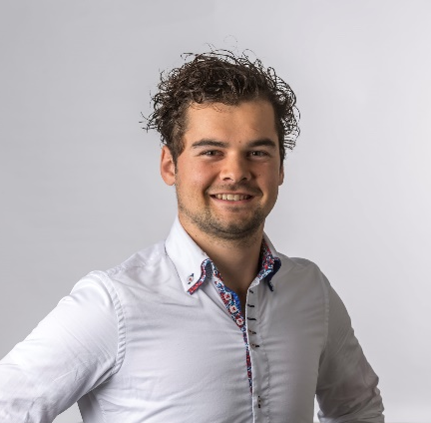
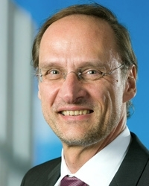
Questions?
Roy de Winter*, Bas van Stein, Thomas Bäck
Team: Roy de Winter*, Bas van Stein, Thomas Bäck
{r.de.winter, b.van.stein, t.h.w.baeck}@liacs.leidenuniv.nl
Notes:
In case you have any questions, do not hesitate to ask them now or by sending any of our team members an email.

