Slide 1
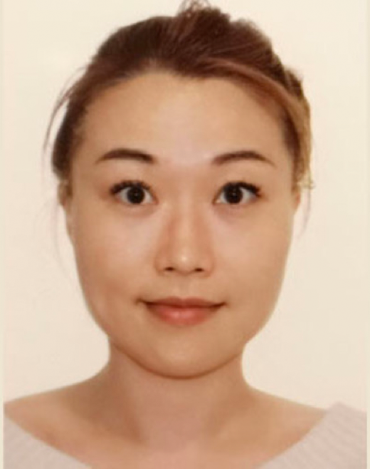
Enhancing Robot Evolution through Lamarckian Principles
Published in Nature Scientific Reports: https://www.nature.com/articles/s41598-023-48338-4
Authors:
Jie Luo Karine Miras Jakub Tomczak Guszti Eiben

Slide 3
Main goals
Study Lamarckism's effects on morphologically evolvable robots for valuable insights.
Solve the reversible genotype-phenotype mapping problem and create a general framework for evolution and learning
Compare the Lamarckian system to a Darwinian system

Slide 4
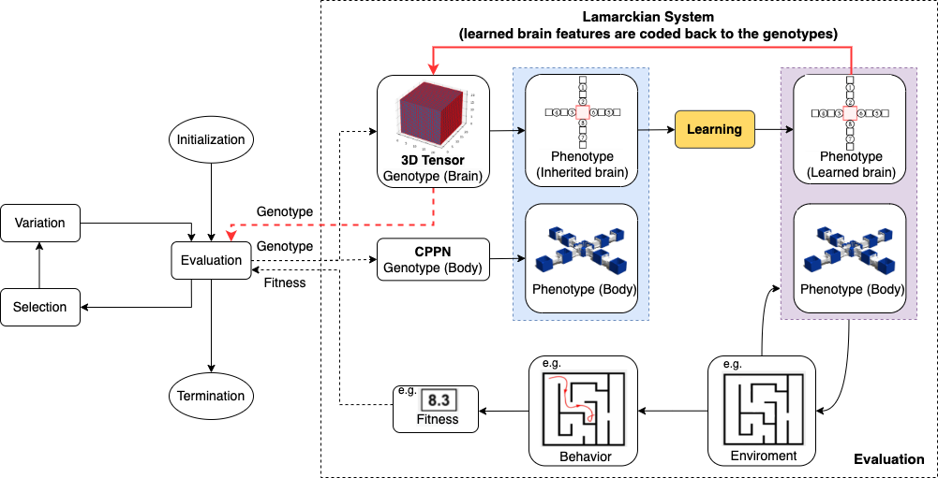
Methods & Experiments
Evolution + Learning Framework

Slide 5
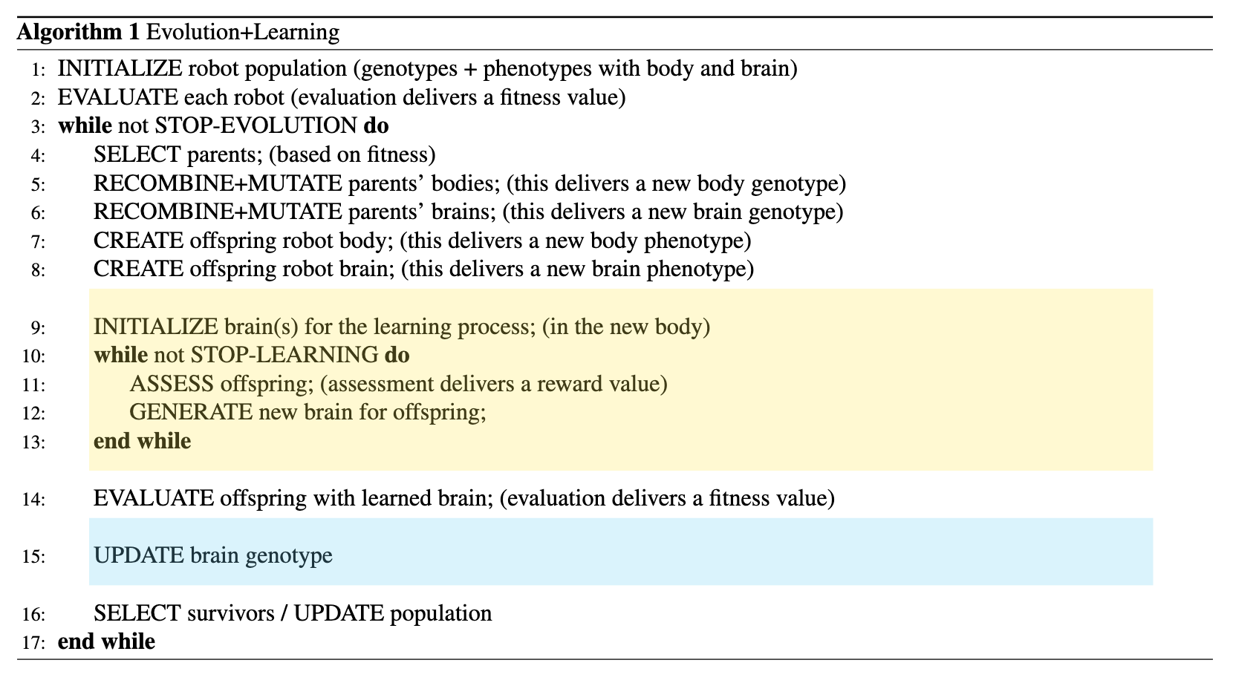
Methods & Experiments
Evolution + Learning (Lamarckian vs Darwinian systems)

Slide 6
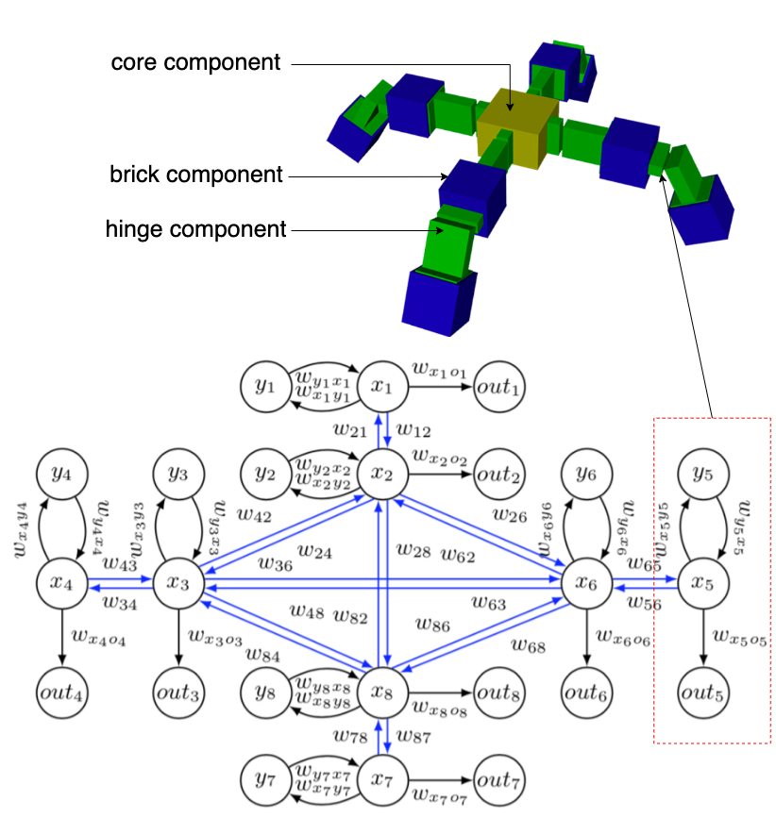
Methodology & Experiments
Phenotype
Body
Brain

Slide 7
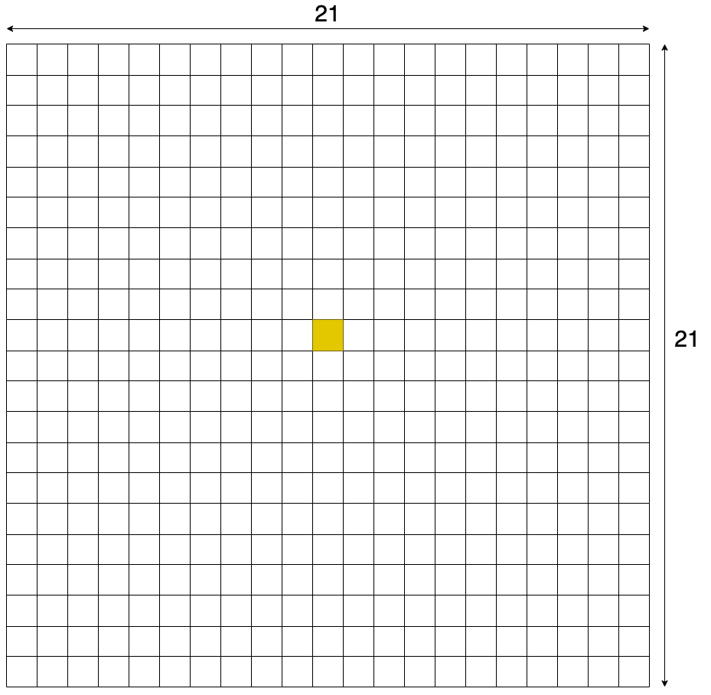
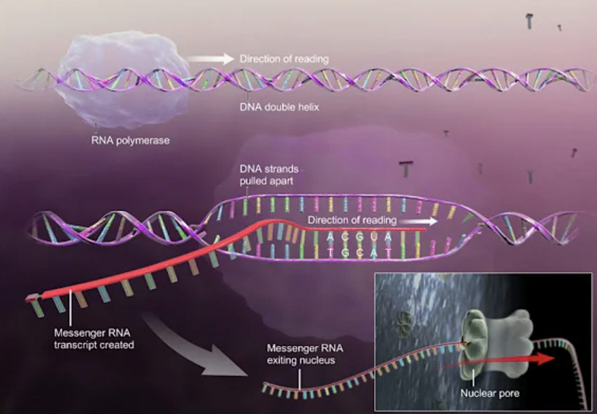
Methodology & Experiments
Brain genotype
Internal weights of every possible CPG: 21*21-1=440

Slide 8
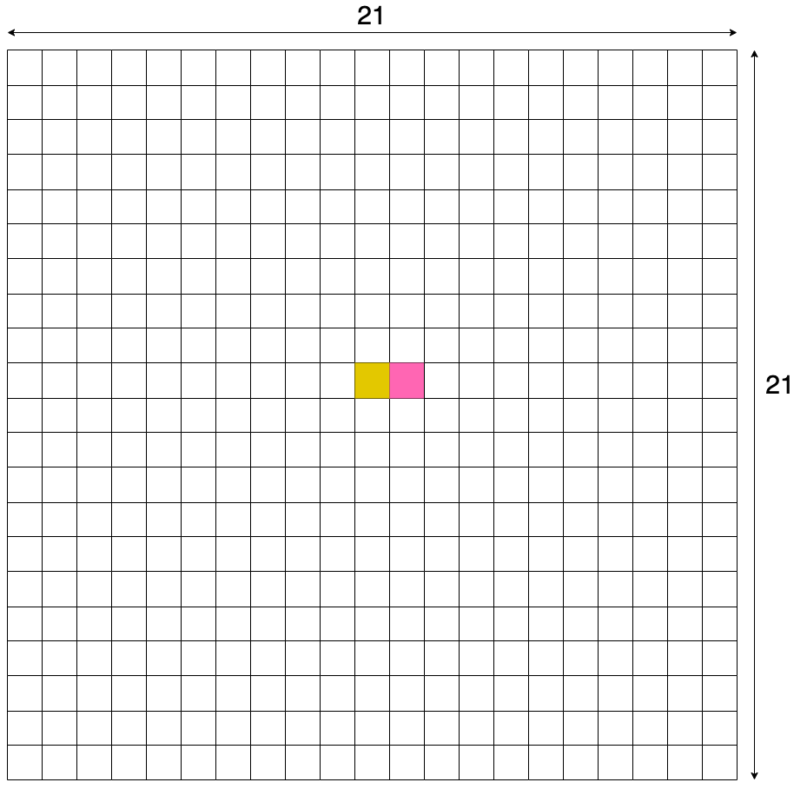
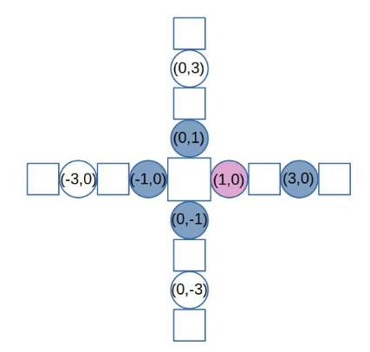
Methodology & Experiments
Brain genotype
Every possible CPG: 21*21-1=440

Slide 9
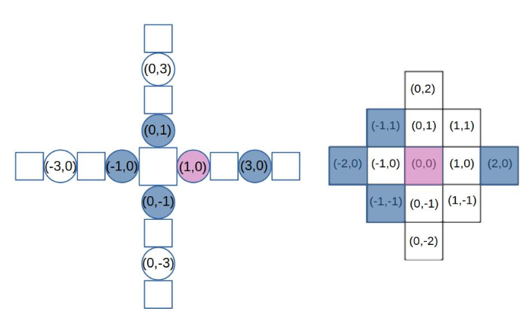
Methodology & Experiments
Brain genotype
For each CPG: 1 internal weight;
12 external weights: Delannoy number D(2,2) -1=12; 1 weight for connections with CPGs at the same coordinate
Every possible CPG: 21*21-1=440

Slide 10
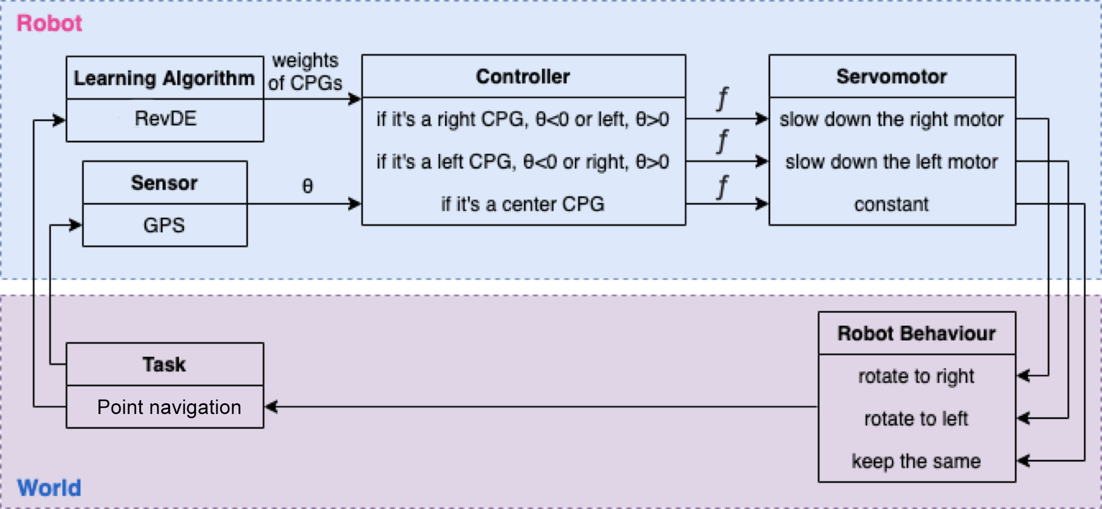
Methods & Experiments
Controller Steering Architecture
Task: Point Navigation
Angle θ is calculated using the coordinates of the robot, its current heading, and its target. Function f, which uses the output of the CPGs and θ, is then used to calculate the final signal going to the joints.

Slide 11
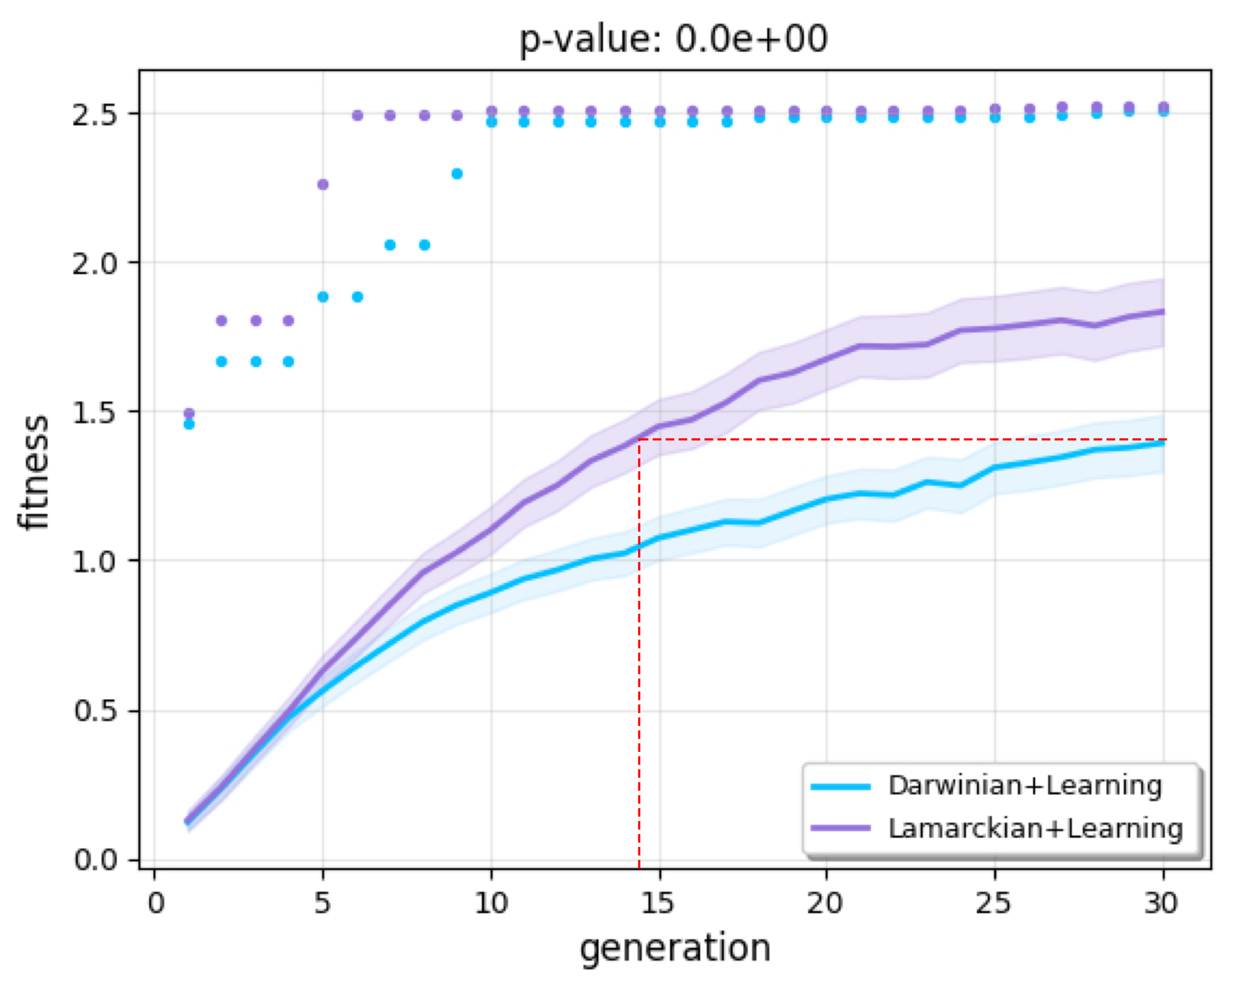
Results: Task Performance

Slide 12
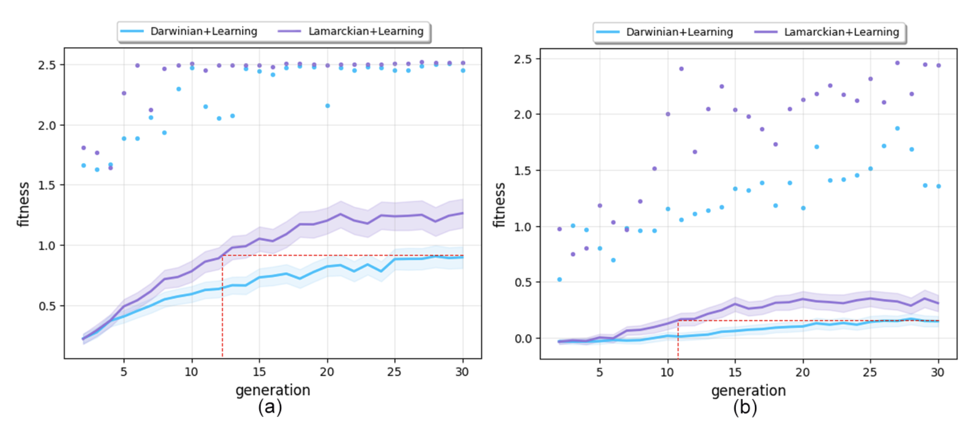
Results: Task Performance
Newborn robots after learning (a) and before learning (b)

Slide 13
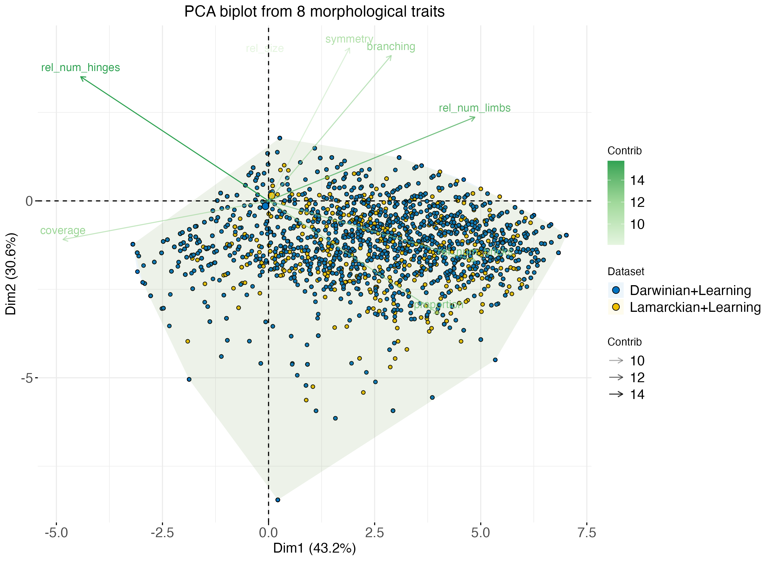
Results: Morphological traits

Slide 14
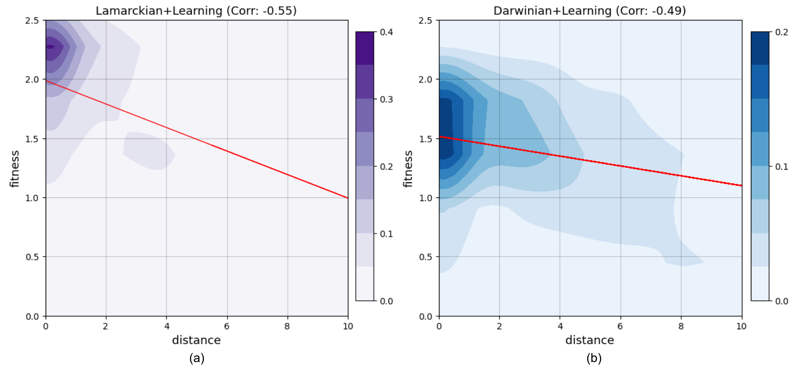
Results: Morphological parent-child similarity

Slide 15
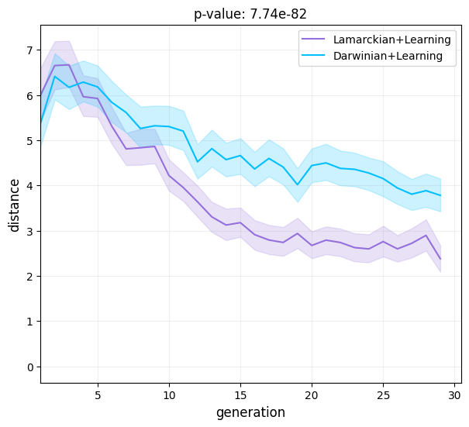
Results: Morphological parent-child similarity

Slide 16
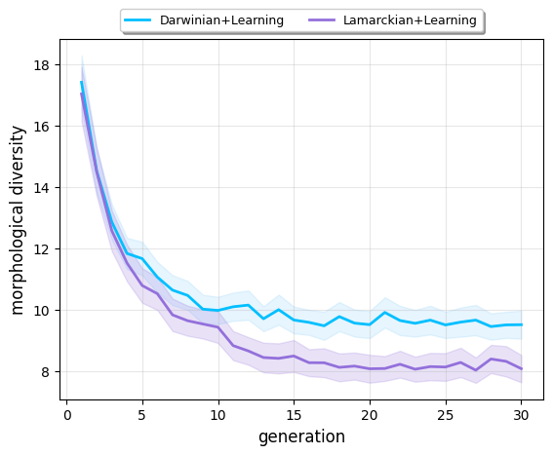
Results: Morphological diversity

Slide 17
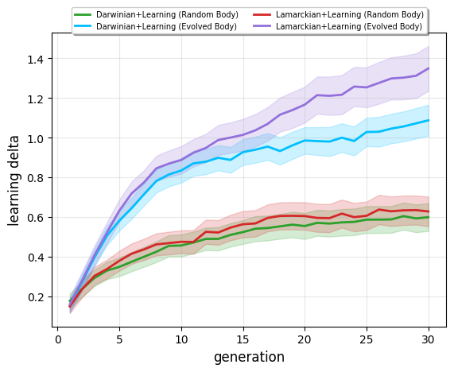
Results: Morphological intelligence

Slide 18
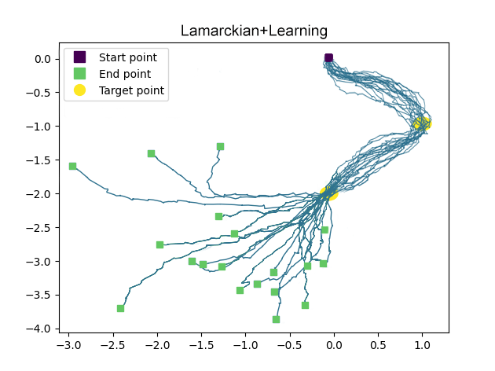
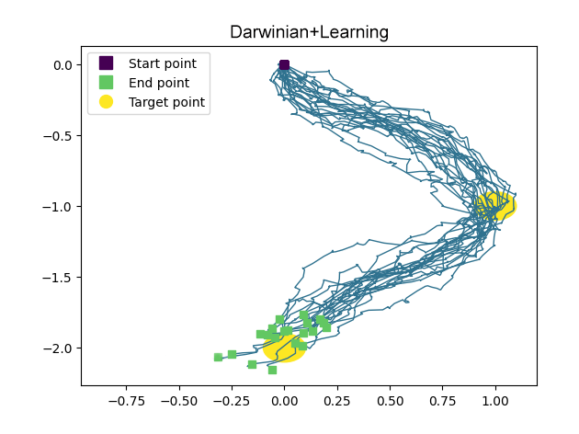
Results: Robot Behavior

Slide 19
Conclusion
Task performance: Lamarckian system is the winner
Morphology: Similar to the parent, converges into superior bodies faster (flat terrain), and becomes better learners
Behaviours: Lamarckian system reached the second target point much earlier
Future work: dynamic environments, physical robots, analyze brain genotype

