Slide 1
Optimal Mixing Evolutionary Algorithms for Large-Scale Real-Valued Optimization
Anton Bouter
Scientific Software Developer
Life Science & Health Group, Centrum Wiskunde & Informatica (CWI), Amsterdam
15-09-2021

Slide 2

About me
2020 – present: Scientific Software Developer, LSH group, CWI
2016 – 2020: PhD Candidate, LSH group, CWI
Promotor: Prof. dr. Peter A.N. Bosman
Project: ICT-based Innovations in the Battle against Cancer - Next-Generation Patient-Tailored Brachytherapy Cancer Treatment Planning
PhD Thesis (under review): Optimal Mixing Evolutionary Algorithms for Large-Scale Real-Valued Optimization
2011 – 2016: BSc & MSc Computer Science, Delft University of Technology
Research topics:
(Model-based) evolutionary algorithms, multi-objective optimization, GOMEA,
GPU parallelization, CUDA, treatment planning, deformable image registration

Slide 3
Outline
Gray-box Optimization (GBO)
Real-Valued Gene-pool Optimal Mixing Evolutionary Algorithm (RV-GOMEA)
RV-GOMEA for prostate cancer treatment planning (HDR brachytherapy)
RV-GOMEA for deformable image registration

Slide 4


Gray-box Optimization - Partial Evaluations
$$x=\left[ x_{1} x_{2} x_{3} x_{4} x_{5} \right]$$
$$f\left(x\right)=g_{1}\left(x_{1},x_{2}\right)+g_{2}\left(x_{2},x_{3}\right)+g_{3}\left(x_{3},x_{4}\right)+g_{4}(x_{4},x_{5})$$
$$x′=\left[ x_{1} x_{2}^{′} x_{3} x_{4} x_{5} \right]$$
$$f\left(x′\right)=f\left(x\right)−g_{1}\left(x_{1},x_{2}\right)−g_{2}\left(x_{2},x_{3}\right)+g_{1}\left(x_{1},x_{2}^{′}\right)+g_{2}(x_{2}^{′},x_{3})$$

Slide 5
Gray-box Optimization - Partial Evaluations
Possible properties of functions to which partial evaluations can be applied:
Non-separable
Non-smooth
Multi-modal
Multi-objective
Etc.

Slide 6
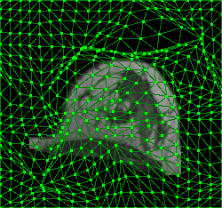
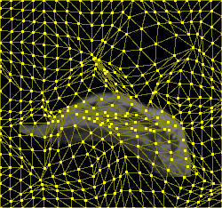
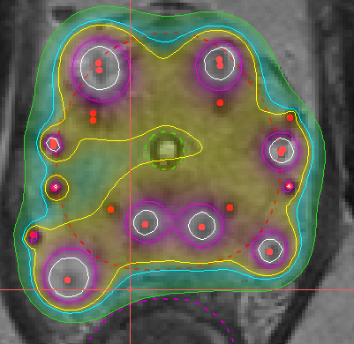
Gray-box Optimization - Partial Evaluations
Deformable image registration [1]:
Optimization of points in triangulated grid to find deformation from image A to B.
Treatment plan optimization for prostate cancer [2]:
Optimization of radiation dose delivered from dwell positions (in red).
[1] A. Bouter et al.; Proc. SPIE, 2017.
[2] N.H. Luong et al.; Swarm and Evolutionary Computation, 2018.

Slide 7
Exploiting Linkage Information
In discrete optimization, linkage information was previously successfully exploited by the Gene-pool Optimal Mixing Evolutionary Algorithm (GOMEA) [3].
GOMEA:
Model-Based Evolutionary Algorithm (MBEA)
Explicitly model dependency structure of problem in linkage model.
Apply crossover to small subsets of variables, defined by linkage model.
Accept only modifications that lead to improved objective value.
Efficiently evaluate modifications through partial evaluations.
Linkage model:
Univariate – No dependencies
Marginal product model – Non-overlapping dependencies
Linkage tree – Hierarchical dependencies
Example of a linkage tree.
Each node of the tree defines a linkage set.
[3] D. Thierens, P.A.N. Bosman; Proc. GECCO, 2011.

Slide 8
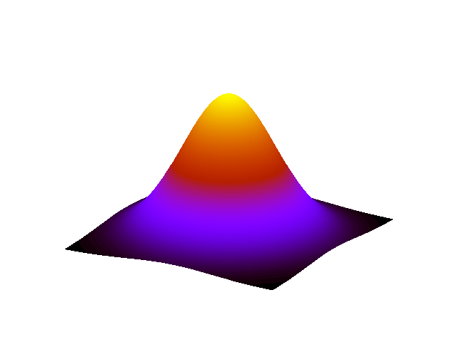
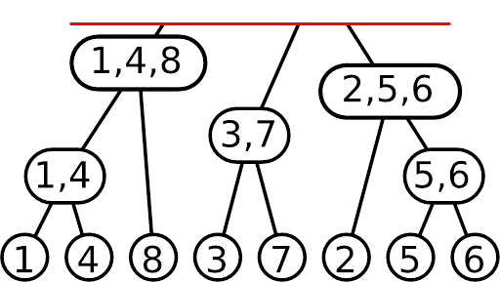
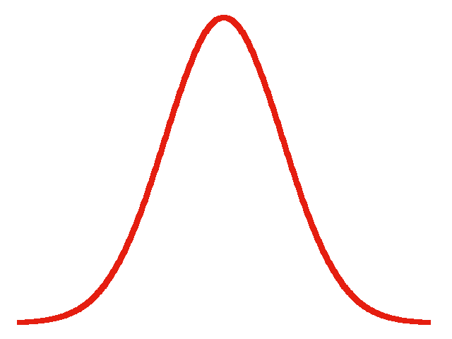
Real-Valued GOMEA [4,5]
Population of potential solutions
Updated accordin to AMaLGaM [5]
Linkage model
Selection
Variation
Estimate distribution of problem variables
Gene-pool Optimal Mixing (GOM)
[4] A. Bouter et al.; Proc. GECCO, 2017.
[5] A. Bouter et al.; Evolutionary Computation, 2021.

Slide 9
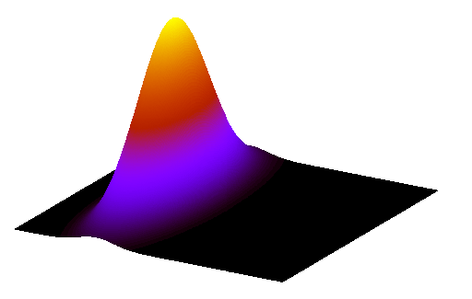
Gene-pool Optimal Mixing
Parent from population
1 | 2 | 3 | 4 | 5 | 6 | 7 | 8
1.12 | 6.44 | 10.3 | 0.52 | 72.1 | 8.49 | 2.10 | 6.75
Sampled
partial solution
f ↑
1 | 2 | 3 | 4 | 5 | 6 | 7 | 8
1.12 | 6.44 | 2.36 | 0.52 | 72.1 | 8.49 | 0.58 | 6.75
3 | 7
2.36 | 0.58
f ↓
1 | 2 | 3 | 4 | 5 | 6 | 7 | 8
1.12 | 6.44 | 2.36 | 0.52 | 62.3 | 11.2 | 0.58 | 6.75
5 | 6
62.3 | 11.2
f ↑
3
1.18
1 | 2 | 3 | 4 | 5 | 6 | 7 | 8
1.12 | 6.44 | 1.18 | 0.52 | 72.1 | 8.49 | 0.58 | 6.75

Slide 10
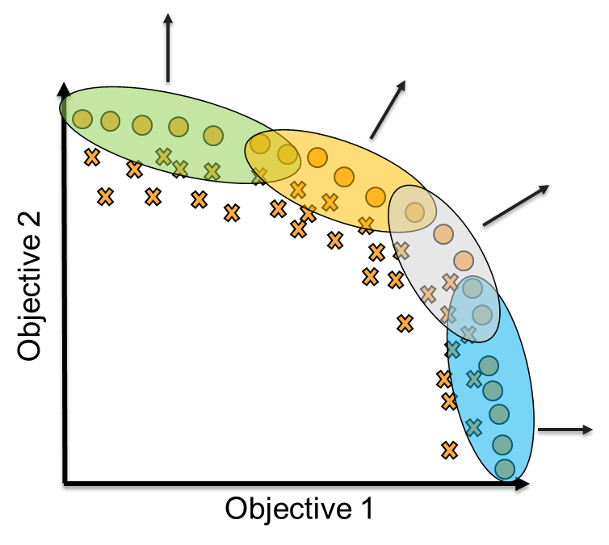
Multi-Objective RV-GOMEA - Clustering

Slide 11
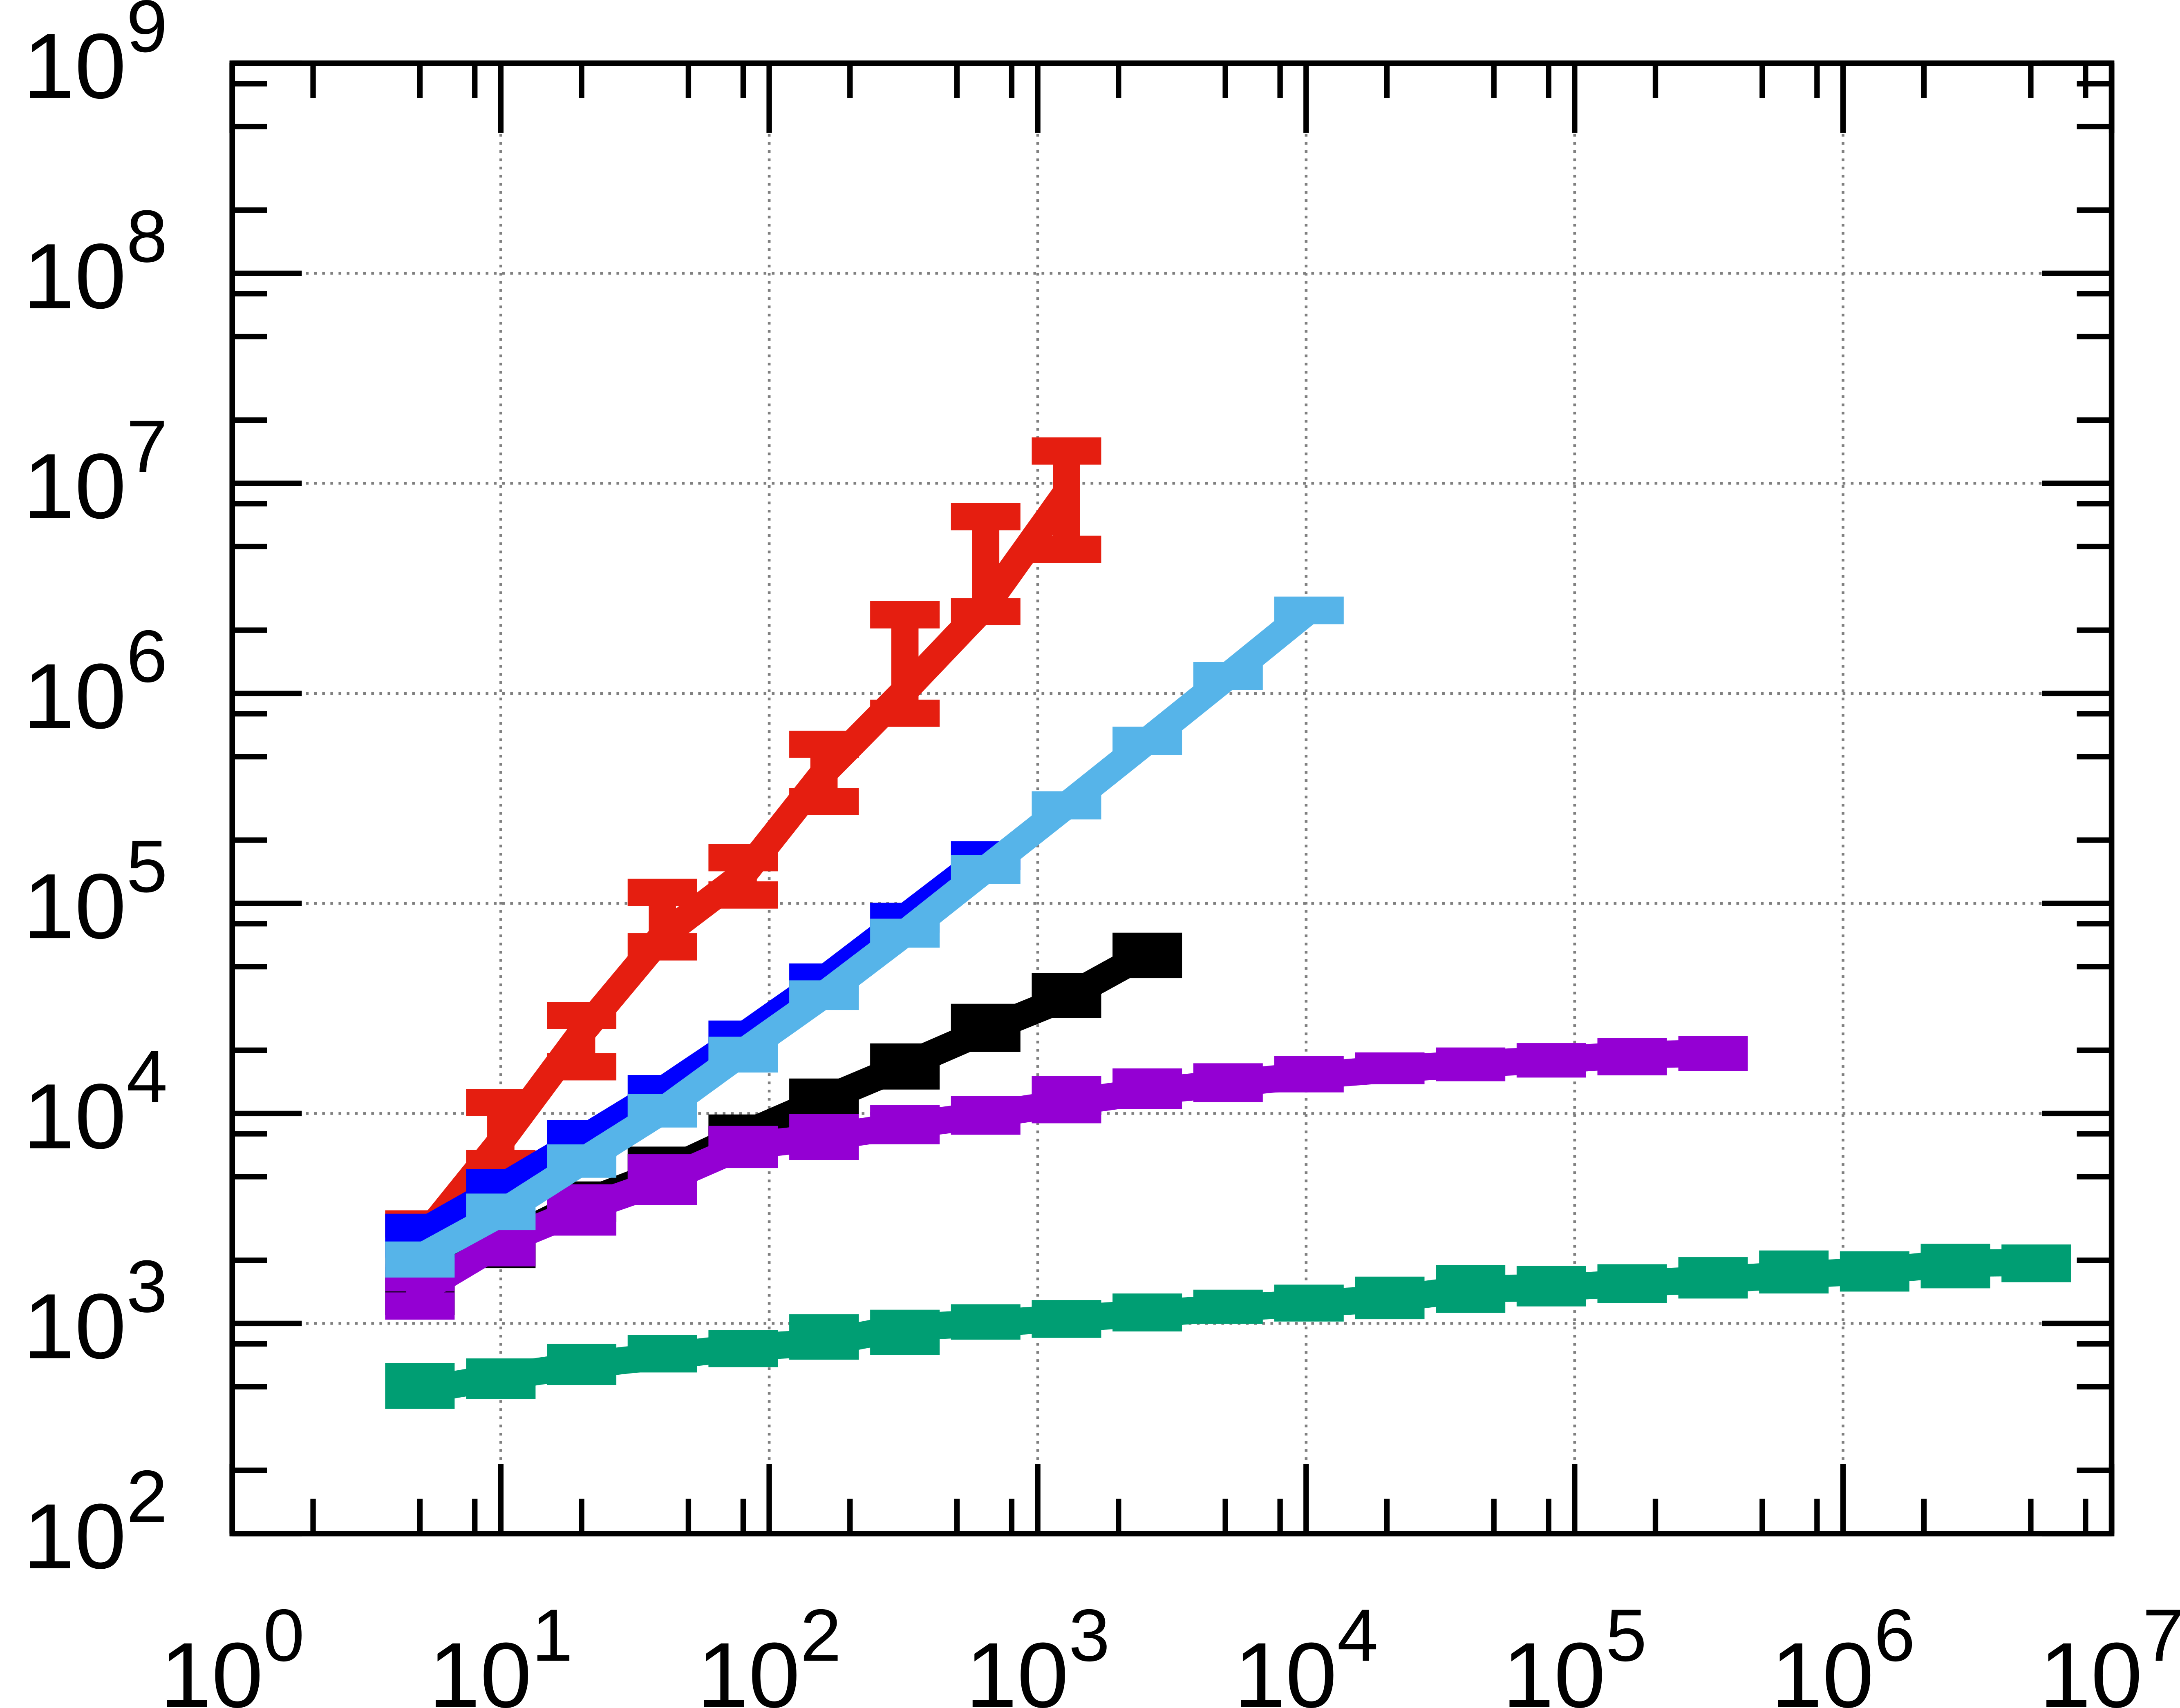
Scalability Analysis – Sphere (GBO)
Number of evaluations
Dimensionality

Slide 12
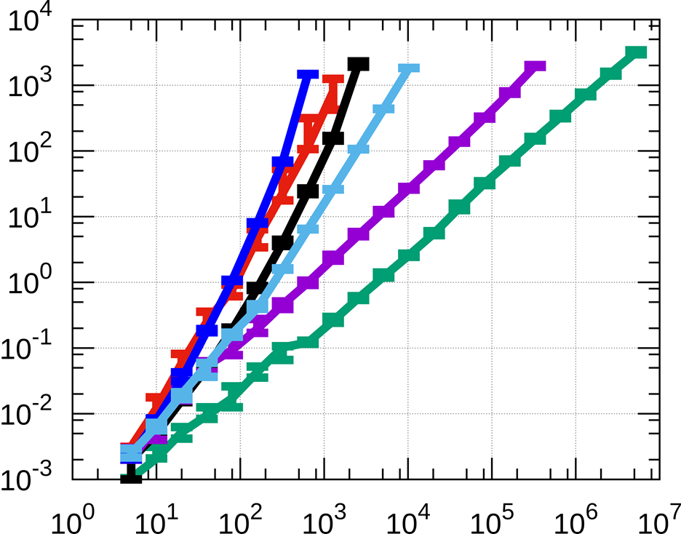
Scalability Analysis – Sphere (GBO)
Time (s)
Dimensionality

Slide 13
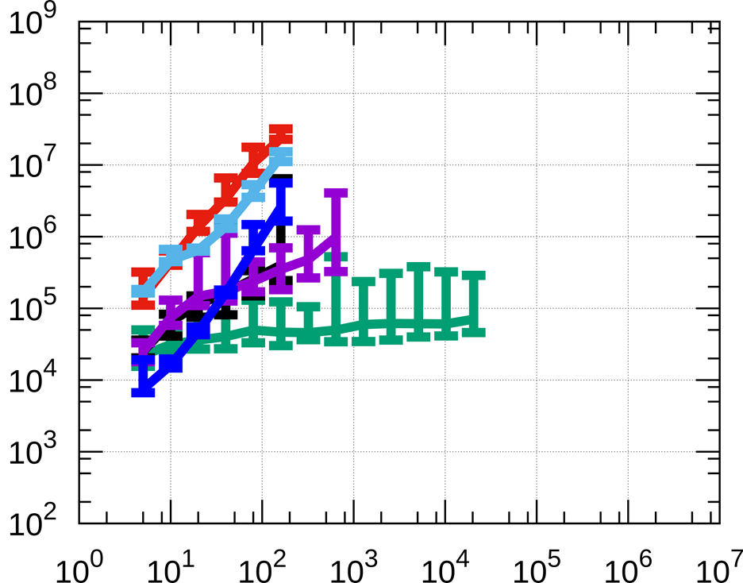
Scalability Analysis – Rosenbrock (GBO)
Number of evaluations
Dimensionality

Slide 14
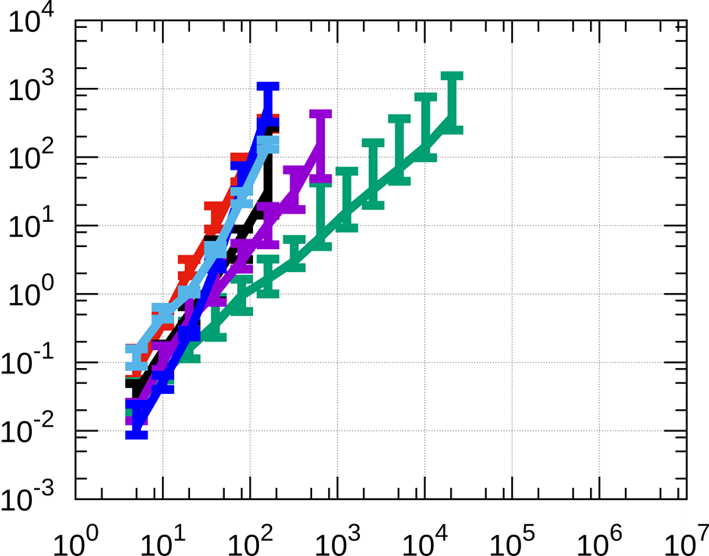
Scalability Analysis – Rosenbrock (GBO)
Time (s)
Dimensionality

Slide 15
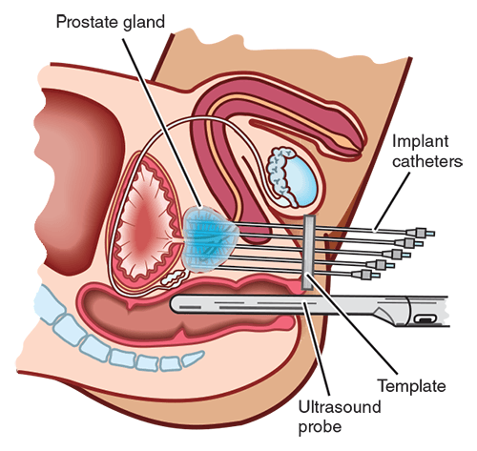
Prostate HDR Brachytherapy
Source: Understanding Brachytherapy for Prostate Cancer, Prostate Cancer Foundation of Australia
Notes:
http://www.prostate.org.au/awareness/further-detailed-information/understanding-prostate-cancer-treatments-and-side-effects/understanding-brachytherapy-for-prostate-cancer/
Each position is called a dwell position
Each time is called a dwell time

Slide 16
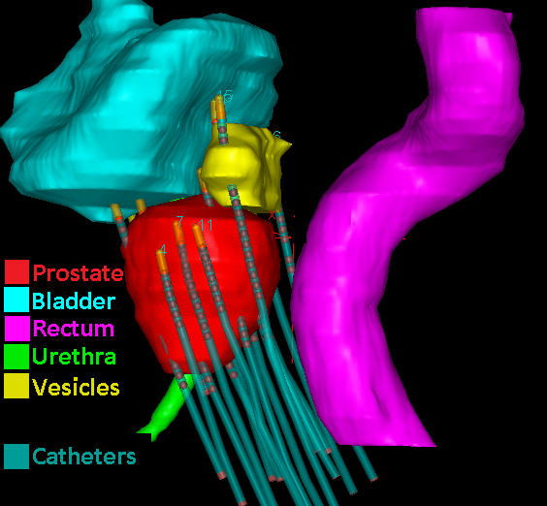
Prostate HDR Brachytherapy

Slide 17
Multi-Objective Optimization
Non-dominated
Trade-off:
Covering target organs
Sparing Organs At Risk (OAR)
Sparing (Least Sparing Index)
Dominated
Coverage (Least Coverage Index)
Notes:
- Recall trade-off between coverage and sparing

Slide 18
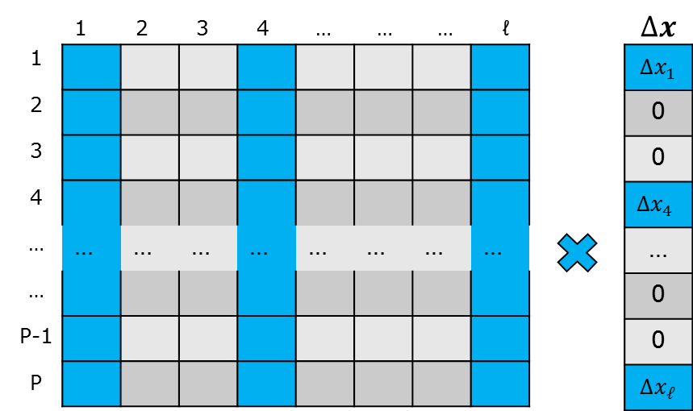
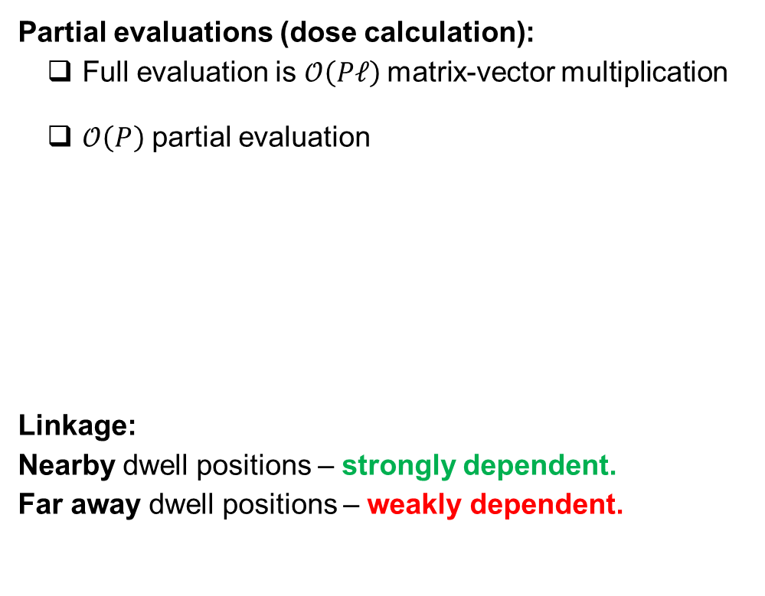
Gray-box Optimization
Partial evaluations (dose calculation):
Full evaluation is $𝒪\left(Pℓ\right)$matrix-vector multiplication
$𝒪\left(P\right)$ partial evaluation
Linkage:
Nearby dwell positions – strongly dependent.
Far away dwell positions – weakly dependent.

Slide 19
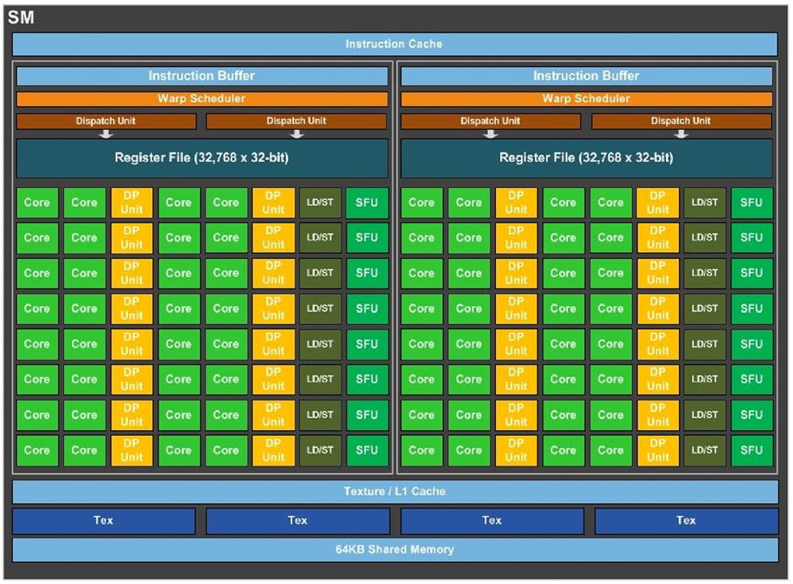
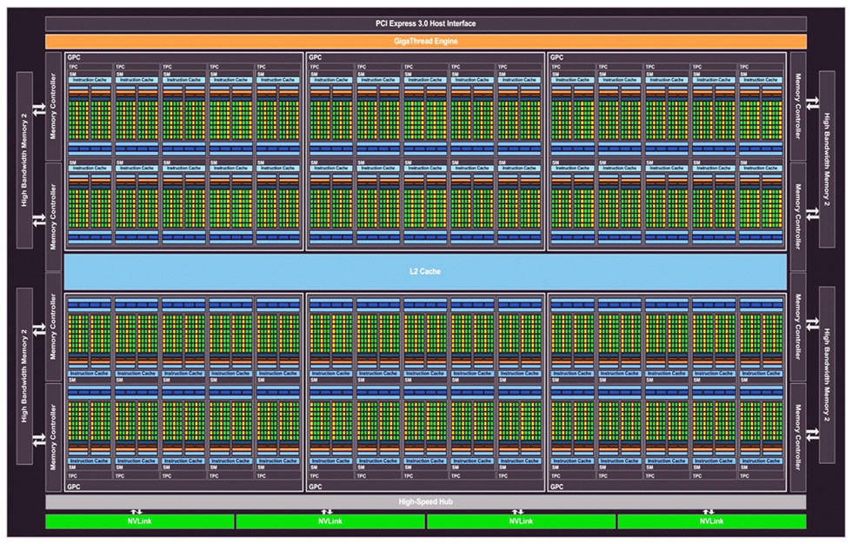
GPU-accelerated treatment planning
Performance improvement:
  Algorithmic and dose calculation accelerations [6,7]
  Parallelization on Graphics Processing Unit (GPU)
[6] A. Bouter et al., Proc. ESTRO, 2019.
[7] A. Bouter et al., Medical Physics, 2019.
Image credit: nvidia.com
Notes:
Population-based optimization method, making it excellent at multi-objective optimization
State of the art evolutionary algorithm that we recently developed
Allows for problem-specific enhancements that greatly improve performance on inverse treatment planning
Previously validated in a restrospective observer study

Slide 20
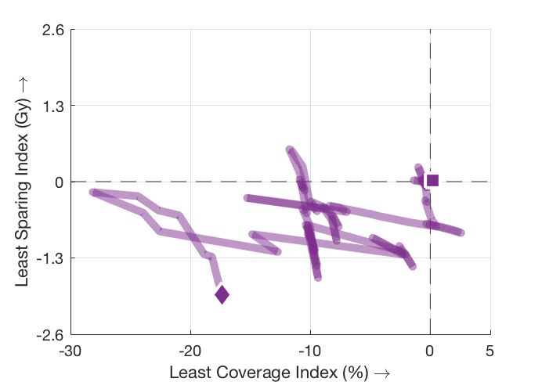
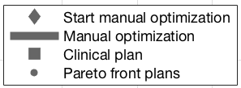
Results

Slide 21
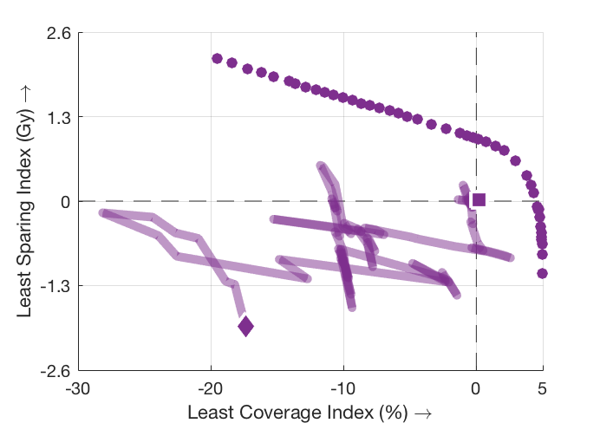
Results

Slide 22
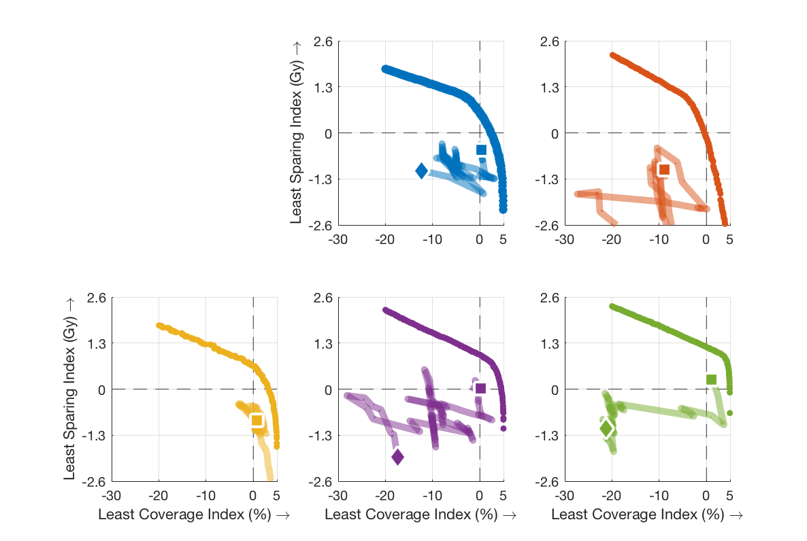
Results
[8] S.C. Maree et al.; Brachytherapy, 2019.

Slide 23
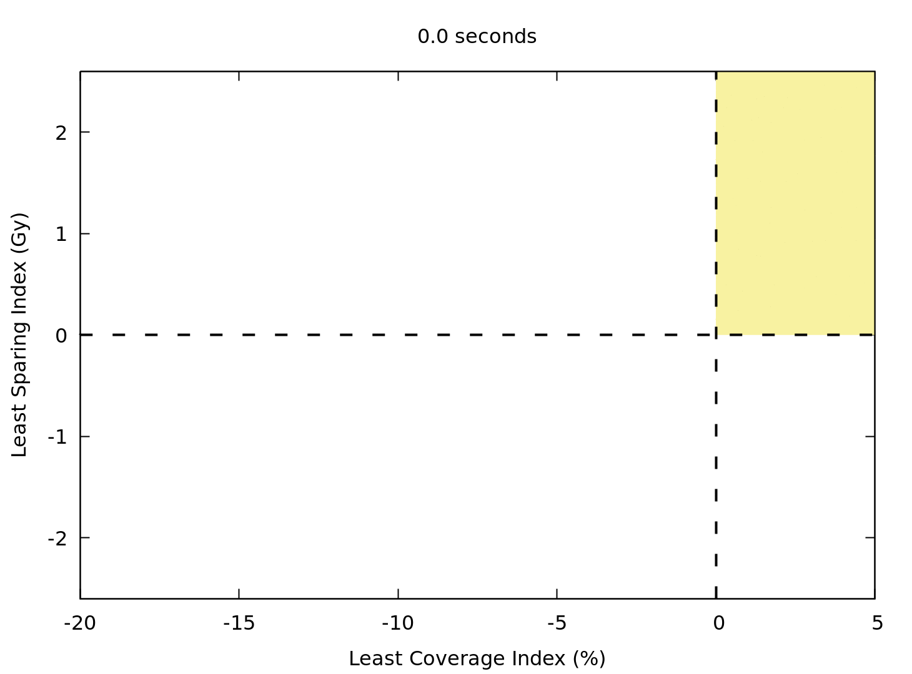

Slide 24

Clinical practice

Slide 25
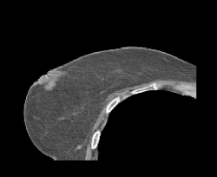
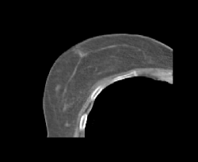
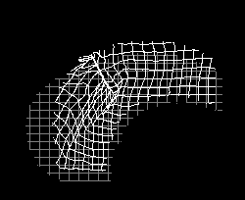
Deformable Image Registration
Source image
Target image
Non-rigid transformation

Slide 26
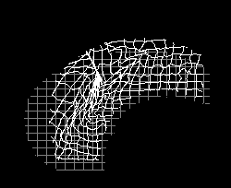
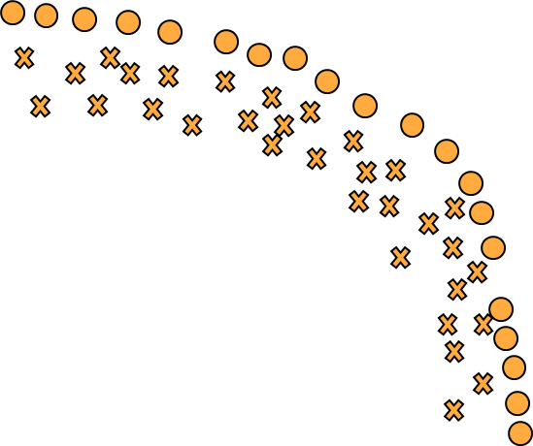
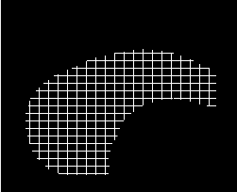
Multi-Objective Deformable Image Registration
Similarity
Deformation
Notes:
- Show golden corner

Slide 27
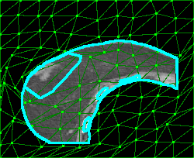
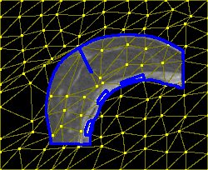
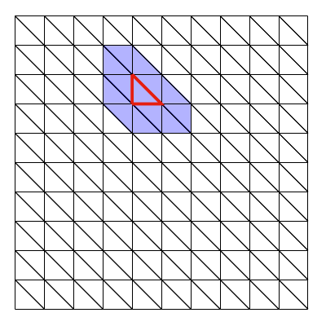
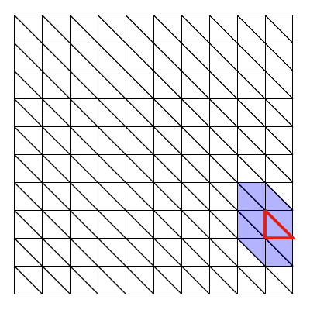
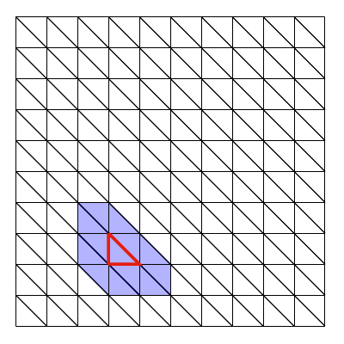
Dual-Dynamic Grid Transformation Model
Optimization problem:
2-3 objectives
n × n grid -> 4n real-valued variables
Local (cascading) dependencies
Non-separable
Allows for partial evaluations.

Slide 28
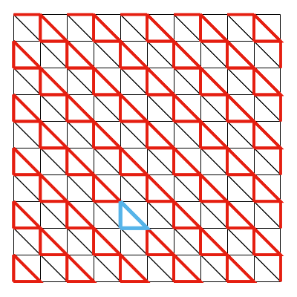
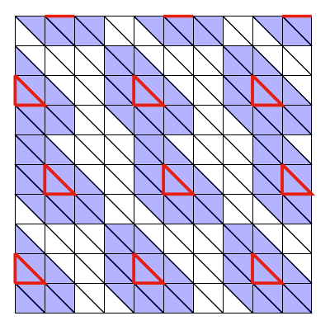
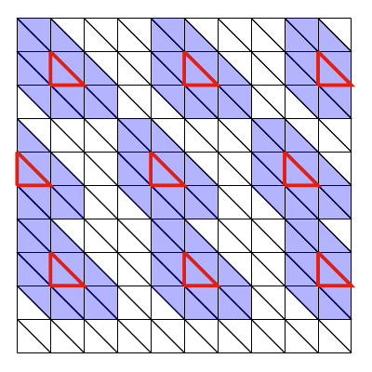
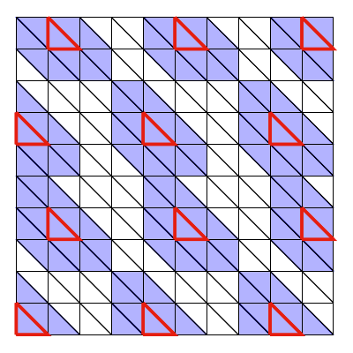
Parallel Gene-pool Optimal Mixing
Parallel application of improving variation steps to independent sets of variables.
Distribute triangles into mutually independent parallel groups.
Parallel group 3
Parallel group 1
Parallel group 2
12 groups
(source + target grid)
[9] A. Bouter et al.; IEEE CEC, 2021.

Slide 29
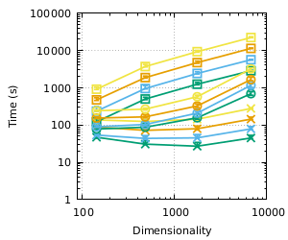
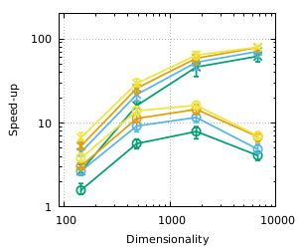
Experiments
Population size
Baseline (CPU)
Serial GOM (GPU)
Parallel GOM (GPU)

Slide 30






Summary and Conclusions
Exploiting problem information in a GBO setting can greatly improve efficiency.
RV-GOMEA is very well capable of exploiting GBO setting.
Excellent performance on real-world problems of treatment planning for HDR prostate brachytherapy and deformable image registration.
Acknowledgments:
CWI: N.H. Luong, P.A.N. Bosman
Amsterdam UMC: S.C. Maree, M.C. van der Meer, A. Bel, B.R. Pieters, C. Koedooder, N. van Wieringen, D.L.J. Barten, E. Jansen
Leiden UMC: T. Alderliesten
Elekta: Y. Niatsetski, J. Schillings, B. van Veelen, R. Zinkstok

