Slide 1
The Serial Safety Net: Efficient concurrency control on modern hardware
Tianzheng Wang Ryan Johnson Alan Fekete Ippokratis Pandis
Notes:
1

Slide 2
Modern HW: CPU on critical path
Classic DBMS
Modern DBMS
Locks
Disks
Threads
Memory
Disk
Threads
Low parallelism
Focus: hide I/O stalls
High parallelism
Focus: minimize cycles
Main-memory OLTP: more pressure on CC
Notes:
Common solution is to use OCC, b/c it’s lightweight, easy to implement, serializable, etc.

Slide 3
CC: current state of the art
SSI (slow)
Contentious TPC-C variant
OCC (fast)
6
12
16
24
SI (non-serializable)
1
OCC looks good. What’s the problem?
Notes:
Optimistic CC – lightweight, serializable
Very popular recently: Hekaton, Silo, etc.
But unfriendly to retries without hacking workload
Multi-version schemes – e.g., snapshot isolation
Serializability is hard
Hurts concurrency – esp. on modern HW
Difficult to get right
Often sacrificed for performance
Serializability is desirable
No anomalies (often required by law)
Makes developers’ life easier

Slide 4
CC: Robustness matters!
6
Contentious TPC-C variant with retries
SSI (slow)
12
OCC (unfair)
16
24
SI (non-serializable)
1
Need all three: fast, fair, serializable

Slide 5
The Serial Safety Net (SSN)
Dictates access pattern
Aborts offenders
Some
CC >= RC
SSN
Might admit anomalies
Cheap certifier
Serializable execution
Works even if CC is buggy
Notes:
Use callouts for the figure
Maybe use a flow

Slide 6
SSN: fast, fair, serializable
SSI
OCC
SI
SSN

Slide 7
Database model
CC decides which
version to read
Multi-version
database
...
R1
R2
R3
R4
R1
R1
R3
Invisible to other readers
Uncommitted write
Captures most CC schemes, incl. 2PL
Notes:
Multi-version database
Writes always replaces latest committed version
Sequential history of writes to a version
CC decides which committed version to read

Slide 8
Serialization graphs and cycles
T1 | r(x,0) |  |  |  |  |  |  | r(y,0) | w(x,-11) | C!!
T2 |  | r(y,0) | w(y,10) | C!!
T3 |  |  |  |  | r(x,0) | r(y,10) | C!!
T1 r:y:w T2 w:x:r T3 r:x:w T1
SI read-only
anomaly
y
T1
T1
T2
T2
commit time
(T3)
T3
x
x
T3
dependency order

Slide 9
Serialization graphs and cycles
T1 commits
last & “closes”
the cycle
“Easy” to detect T3  T1
“Hard” to detect T1 … T3
T1
T2
commit time
SSN: efficiently detect T1 … T3
(T3)
T3
dependency order

Slide 10
SSN in a nutshell
Track T’s earliest successor
Define c(T) = “commit time of T”
P might be a successor of T
Define π(T) = min {c(S) : T … S}
T might close a cycle
Forbid ∃P  T : π(T) ≤ c(P) ≤ c(T)
“exclusion window” of T

Slide 11
Visualizing SSN
T4
T2
T1
T3
T1
T2
π(T4)
(T1)
T4
T3
π(T2)
T5
Exclusion window satisfied
T2
T2
T4
commit time
??
T1
π(T2)
T1
π(T2)
T3
Exclusion window violation
dependency order

Slide 12
Evaluation
System
4 x 6-core Xeon @ 1.8GHz, 64GB DRAM
A variant of Silo* that supports SI and RC
TPC-C w/ random warehouse selection
RC, SI, OCC (Silo), SSI, {SI, RC} + SSN
What to test
General performance/scalability
Fairness for updates vs. reads
Robustness under retries
* Tu et al, “Speedy transactions in multicore in-memory databases”, SOSP`13

Slide 13
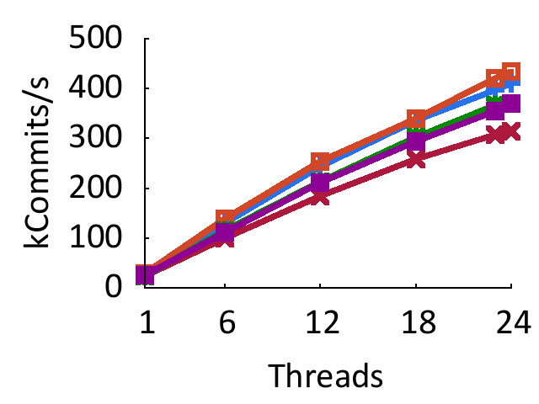
SSN performs well
Higher is better
OCC
SSI
Low implementation overhead
Notes:
Without retry – aborted transactions are dropped

Slide 14
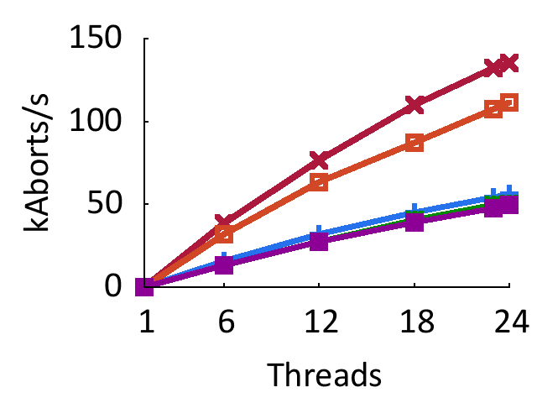
SSN has low abort rate
Lower is better
SSI
OCC
SI (higher)
and
RC/SI+SSN
SSN allows more valid schedules than SSI or OCC
Notes:
SSN has low abort rates than SSI and OCC

Slide 15
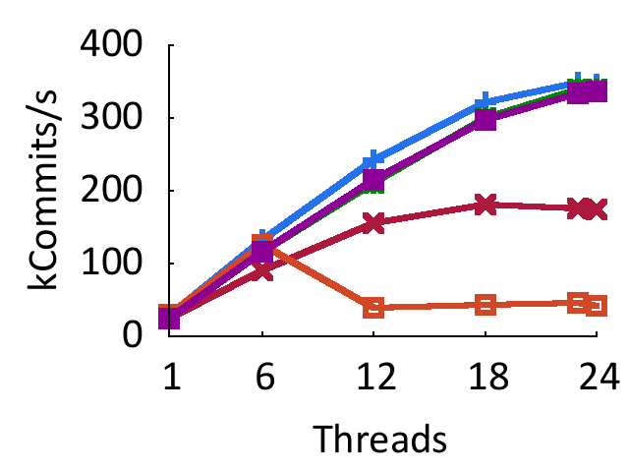
SSN provides “safe retry”
Higher is better
SI (highest)
and
RC/SI+SSN
SSI
OCC

Slide 16
SSN is fair
OCC starves readers
SSI starves writers
SSN fair to both R & W
Ideal OCC SSI SI SI+SSN RC+SSN

Slide 17
Conclusion
Modern HW puts more pressure on CC
No tolerance for CC with “heavy touch”
Serializability becomes even harder
Serial safety net – a cheap certifier
Serializable
Compatible with various CC schemes
Lightweight and balanced
Formal proofs (+ more details) in our paper
Thank you!

