Slide 1
Energy-Efficient Query Processing on Embedded CPU-GPU Architectures
Xuntao Cheng, Bingsheng He, Chiew Tong Lau
Nanyang Technological University, Singapore

Slide 2
Outline
Motivations
System Design
Evaluations
Conclusion

Slide 3
Query Processing in the Era of IoT
IoT devices collect a lot of information and stores them in databases like SQLite, MySQL and SQL Server Express.
These lightweight databases evaluate user queries from many mobile applications.
Energy consumption of query processing is important on such battery-powered systems.

Slide 4
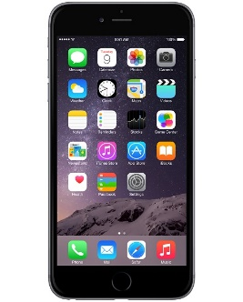
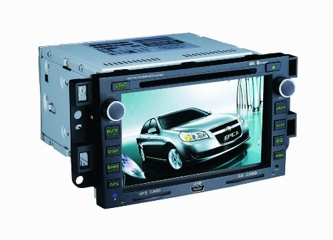
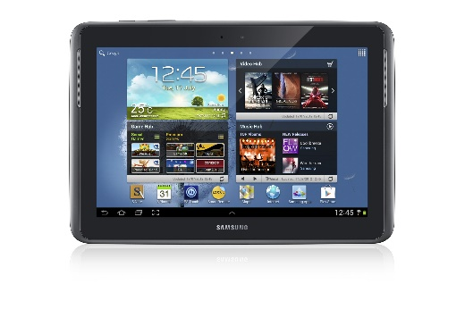
Embedded GPUs are Emerging
Embedded GPUs have been incorporated in new-generation embedded devices.
They offer higher performance for video/image processing than embedded CPUs.
However, they have higher powers than embedded CPUs.

Slide 5
The Embedded CPU-GPU Architecture
 | CARMA | GPU Workstation
CPU | ARM Cortex-A9 (quad-core, 1.3GHz, ~ 9W) | Intel Xeon E5-2650 (6-core, 2GHz, ~ 95W)
GPU | NVIDIA Quadro 1000M (96-core, ~ 45W) | NVIDIA Tesla K40C (2880-core, ~ 245W)
Memory | 2GB | 16GB
Storage | 4GB eMMC | 256GB SSD
PCI | 4x PCIe Gen 1 (250MB/s) | 16x PCIe Gen 3 (985MB/s)
Idle power | ~ 10W | ~ 80W
Peak power | ~ 50W | ~ 400W
The power of the embedded GPU is 5 times higher than its CPU counterpart.
The power of CARMA is 8 times lower than a workstation.

Slide 6
Our Questions
Is it more energy-efficient to use embedded GPUs for query processing?
Challenge: the embedded GPU is more powerful, but it consumes more power.
Can we further improve the energy efficiency by exploiting CPU-GPU co-processing on such embedded CPU-GPU architectures?
Challenge: PCIe bus is slow.

Slide 7
Outline
Motivations
System Design
Evaluations
Conclusion

Slide 8
Methodology
Build a query processor on CARMA.
Consider three types of executions:
CPU-only, GPU-only, and CPU-GPU co-processing.
Two complementary approaches
Micro-benchmarks: individual query operators
Macro-benchmarks: queries (e.g., TPC-H)
1-σ σ
GPU core
GPU core
GPU core
GPU core
GPU core
GPU core
GPU core
GPU core
CPU core
GPU core
GPU core
GPU core
GPU core
GPU core
GPU core
GPU core
GPU core
Notes:
of four query operators and two TPC-H queries

Slide 9
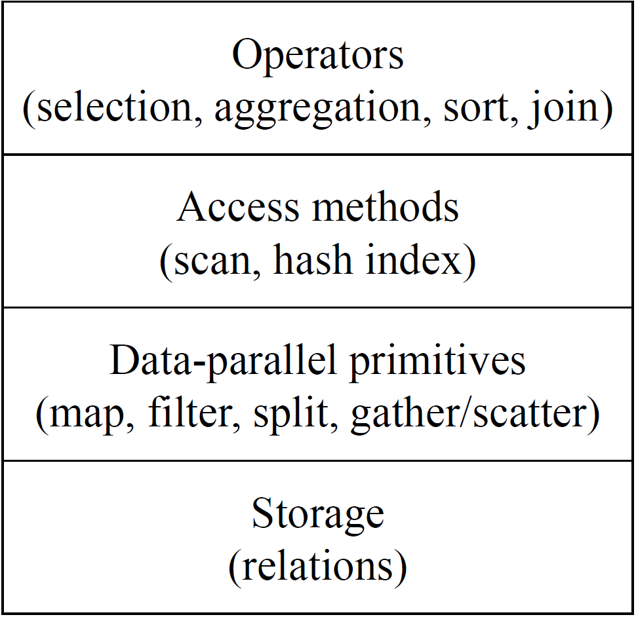
Layered Design of the Query Engine
Four common operators as micro-benchmarks.
Scan and hash indexes require relatively fewer storage.
CPU/GPU parallel algorithms are used for each primitive.
Relations are stored in the column stores.
Layered Design (adopted from GPUQP)

Slide 10
Implementations
CPU
We adopt codes from related work (VLDB’13) and our recent implementation on multi-core CPUs (VLDB’15).
GPU
We adopt codes from our previous work (TODS’09 and VLDB’13).
We re-optimized each CUDA kernel for CARMA.
CPU-GPU co-processing
Inputs are partitioned and distributed between the CPU and the GPU according to σ.
Final results are achieved by merging/concatenating partial results from both processors.

Slide 11
Experiences
Some state-of-the-art libraries cannot be easily cross-compiled.
We have to manually edit the architecture-specific codes and makefiles, and build them from scratch.
Peripherals of CARMA are not stable.
The Ethernet connection occasionally slows down dramatically. HDMI ports are almost broken.
We lack technical means for fine-grained energy measurements.
We cannot measure the power of CPU or the GPU separately.
Power of the board is occasionally abnormal.

Slide 12
Outline
Motivations
System Design
Evaluations
Conclusion

Slide 13
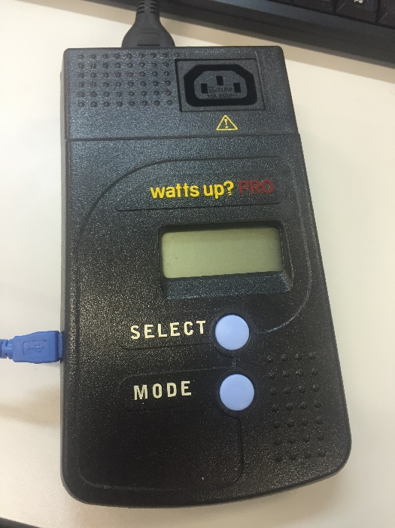
Evaluation Setup
Workloads
Operators: selection, sum, sort and hash join
Queries: TPC-H query 9 and 14
R and S relations
50M tuples each
Two attributes in each tuple: (32-bit key,
32-bit record-ID)
TPC-H query 9 and 14
Scale factor: 0.5 (size=500 MB)
Metrics
Execution time
Energy consumption
Watts up? PRO
power meter

Slide 14
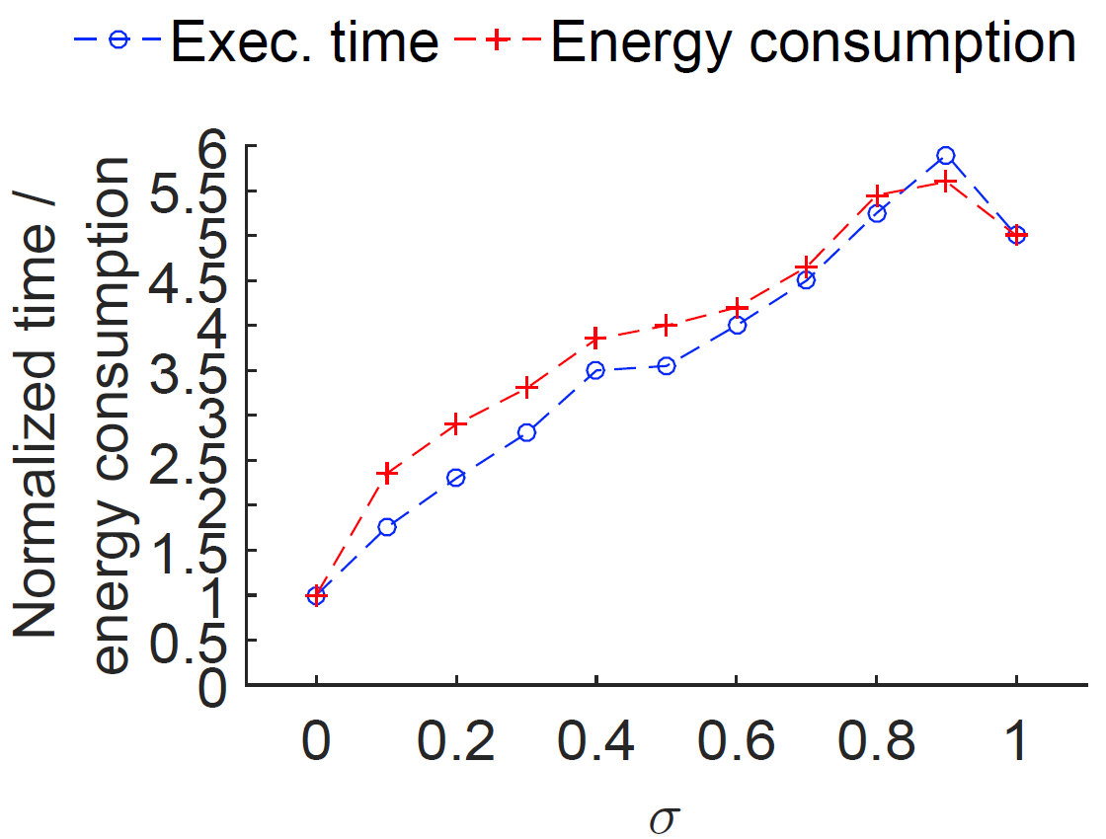
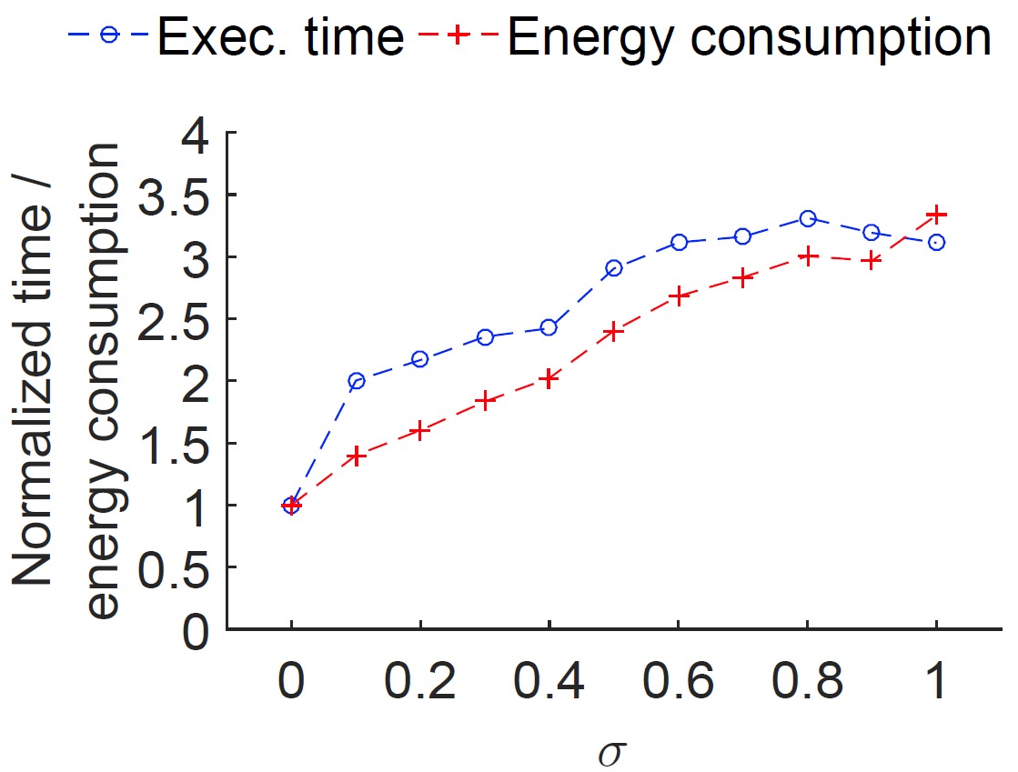
Evaluations: Selection & Sum
Selection
Sum
The CPU-only approach delivers the best performance and the lowest energy consumption for selection and sum which are all memory intensive.
Notes:
Simple 两个轴

Slide 15
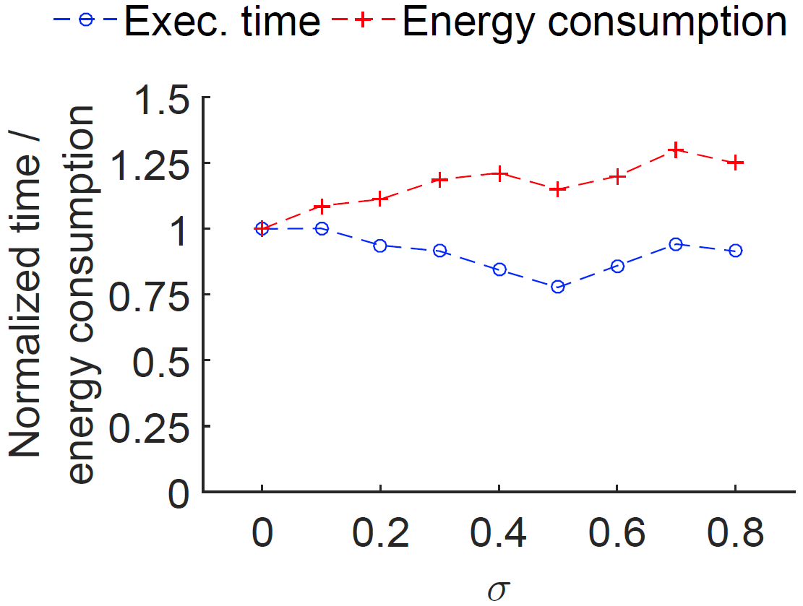
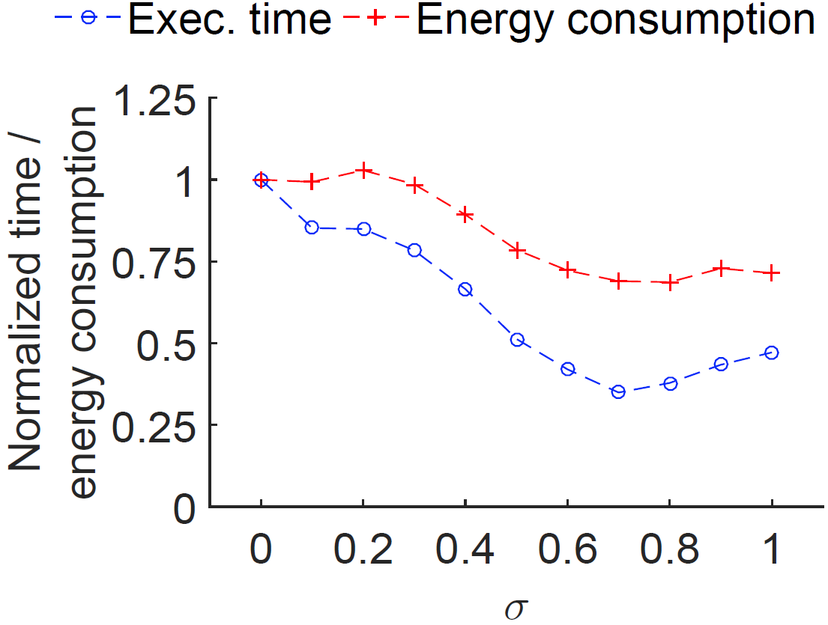
Evaluations: Sort & Hash Join
Sort
Hash join
GPU becomes more competitive when the workload is more computation intensive.
The fastest execution does not always guarantee the lowest energy consumption (e.g., when σ=0.5 in sort).
Notes:
不要断句

Slide 16
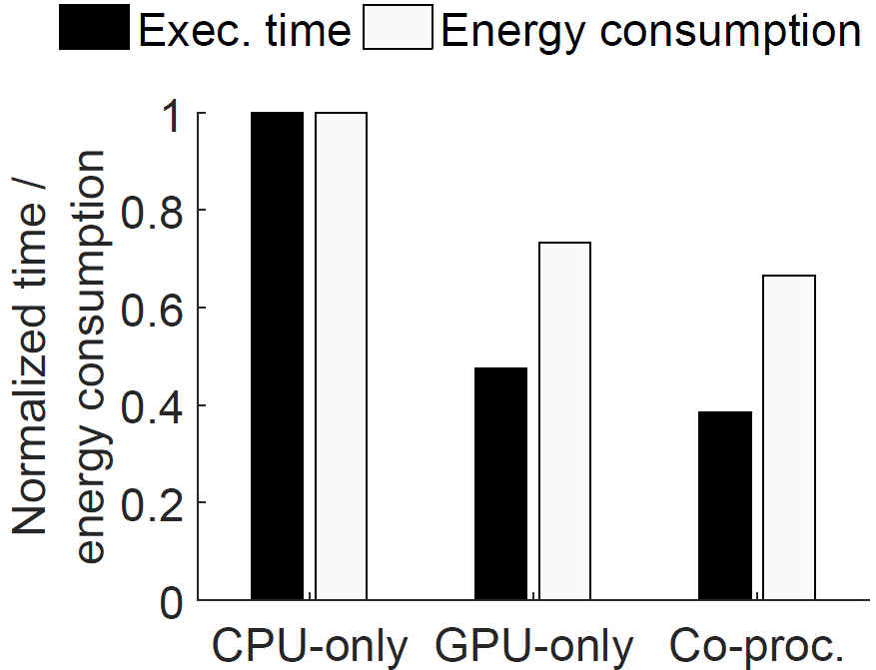
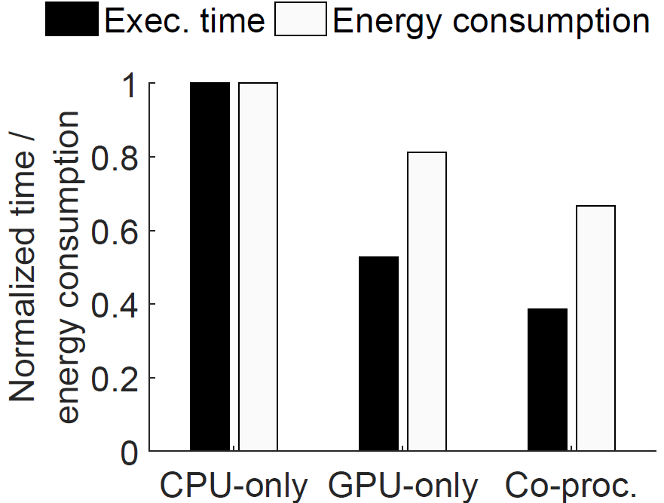
Evaluations: TPC-H Q9 and Q14
Q9
Q14
The GPU-only outperforms the CPU-only for selected analytical queries.
The CPU-GPU co-processing achieves the best performance and the lowest energy consumption.

Slide 17
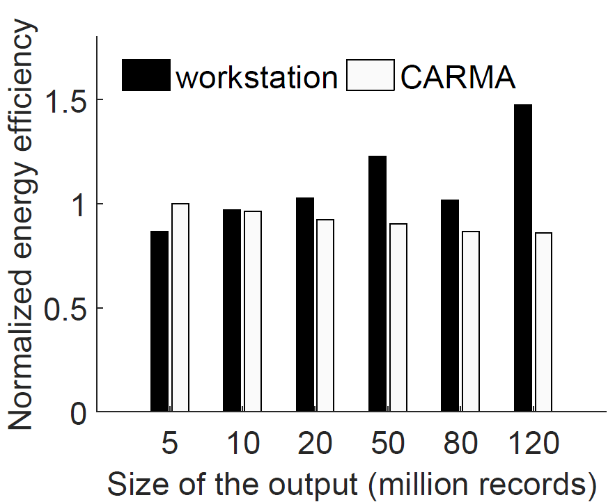
Comparison with a Workstation
Partitioning of input relations are needed for CARMA when the size is larger than 5 million.
CARMA is more energy efficient only when the workload size is small.
Notes:
CARMA; partition的线

Slide 18
Outline
Motivations
System Design
Evaluations
Conclusions

Slide 19
Conclusions
Embedded GPUs have become an integral component in embedded systems.
Although the embedded GPU consumes more power, its higher computation capability and memory bandwidth are still beneficial for energy-efficient query processing.
The embedded CPU is more energy-efficient when processing simple operators such as selection and sum.
The embedded GPU outperforms the embedded CPU for computation-intensive operators such as sort and hash join as well as analytical queries.
The CPU-GPU co-processing can further increase the energy efficiency of query processing on embedded devices.

Slide 20
Towards Energy-Proportional “Wimpy-Node” Cluster
Network
A single UDT connection through the Ethernet can only maintain a speed of 29.8 MB/s.
With Ethernet Jumbo Frames enabled, this can be increased to 41.2 MB/s.
By allocating two CPU cores to handle two connections in parallel, the bandwidth can be further increased to 83.4 MB/s.
Storage
Current results are achieved based on an eMMC storage.
Replacing eMMCs with SSD disks, the energy efficiency of both the CPU-only and GPU-only approach can be increased by 7% and 25% for sort.

Slide 21
Acknowledgement
We thank NVIDIA for the hardware donation.
This work is supported by the following grants and institutions.
The National Research Foundation, Prime Ministers Office, Singapore under its IDM Futures Funding Initiative and administered by the Interactive and Digital Media Programme Office (Grant No.: MDA/IDM/2012/8/8-2 VOL 01).
A MoE AcRF Tier 2 grant (MOE2012-T2-2-067) in Singapore.

Slide 22
Q & A
Thank you.
Our research group: Xtra Computing Group http://pdcc.ntu.edu.sg/xtra/

